Slide 1
Programming Essential in Python
Prepared by Dr. Mohammad Ahmad Safwat

Slide 2
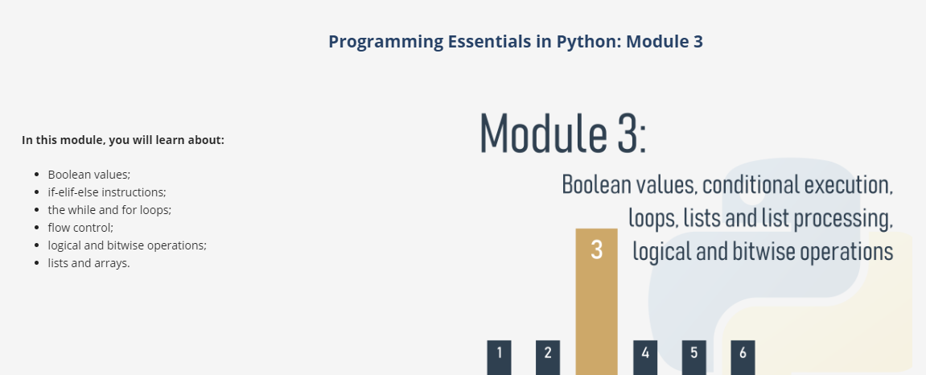

Slide 3
Comparison: equality operator
Question: are two values equal?
To ask this question, you use the == (equal equal) operator.
= is an assignment operator, e.g., a = b assigns a with the value of b;
== is the question are these values equal?; a == b compares a and b.
It is a binary operator with left-sided binding. It needs two arguments and checks if they are equal.
Notes:
A programmer writes a program and the program asks questions.
A computer executes the program and provides the answers. The program must be able to react according to the received answers.
Fortunately, computers know only two kinds of answers:
yes, this is true;
no, this is false.
You will never get a response like Let me think...., I don't know, or Probably yes, but I don't know for sure.

Slide 4
Comparison: equality operator
Question #1: What is the result of the following comparison?
2 == 2
Question #2: What is the result of the following comparison?
2 == 2.
Question #3: What is the result of the following comparison?
1 == 2
Notes:
Question #1: What is the result of the following comparison?
2 == 2 Check
True - of course, 2 is equal to 2. Python will answer True (remember this pair of predefined literals, True and False - they're Python keywords, too).
Question #2: What is the result of the following comparison?
2 == 2. Check
This question is not as easy as the first one. Luckily, Python is able to convert the integer value into its real equivalent, and consequently, the answer is True.
Question #3: What is the result of the following comparison?
1 == 2 Check
This should be easy. The answer will be (or rather, always is) False.

Slide 5


Inequality: the not equal to operator (!=)
The != (not equal to) operator compares the values of two operands, too.
if they are equal, the result of the comparison is False.
If they are not equal, the result of the comparison is True.
Example
Notes:
Equality: the equal to operator (==)
The == (equal to) operator compares the values of two operands. If they are equal, the result of the comparison is True. If they are not equal, the result of the comparison is False.
Look at the equality comparison below - what is the result of this operation?
var == 0 Note that we cannot find the answer if we do not know what value is currently stored in the variable var.
If the variable has been changed many times during the execution of your program, or its initial value is entered from the console, the answer to this question can be given only by Python and only at runtime.
Now imagine a programmer who suffers from insomnia, and has to count black and white sheep separately as long as there are exactly twice as many black sheep as white ones.
The question will be as follows:
black_sheep == 2 * white_sheep Due to the low priority of the == operator, the question shall be treated as equivalent to this one:
black_sheep == (2 * white_sheep) So, let's practice your understanding of the == operator now - can you guess the output of the code below?
var = 0 # assigning 0 to var print(var == 0) var = 1 # assigning 1 to var print(var == 0) Run the code and check if you were right.
Inequality: the not equal to operator (!=)
Now take a look at the inequality comparison below - can you guess the result of this operation?
Run the code and check if you were right.

Slide 6
Comparison operators:
greater than >
greater than or equal to >=
less than or <
less than or equal to <=
All of these operators are
binary operators with left-sided binding
their priority is greater than that shown by == and !=
Notes:
Comparison operators: greater than You can also ask a comparison question using the > (greater than) operator.
If you want to know if there are more black sheep than white ones, you can write it as follows:
black_sheep > white_sheep # greater than True confirms it; False denies it.
Comparison operators: greater than or equal to
The greater than operator has another special, non-strict variant, but it's denoted differently than in classical arithmetic notation: >= (greater than or equal to).
There are two subsequent signs, not one.
Both of these operators (strict and non-strict), as well as the two others discussed in the next section, are binary operators with left-sided binding, and their priority is greater than that shown by == and !=.
If we want to find out whether or not we have to wear a warm hat, we ask the following question:
centigrade_outside ≥ 0.0 # greater than or equal to Comparison operators: less than or equal to
As you've probably already guessed, the operators used in this case are: the < (less than) operator and its non-strict sibling: <= (less than or equal to).
Look at this simple example:
current_velocity_mph < 85 # less than current_velocity_mph ≤ 85 # less than or equal to We're going to check if there's a risk of being fined by the highway police (the first question is strict, the second isn't).

Slide 7
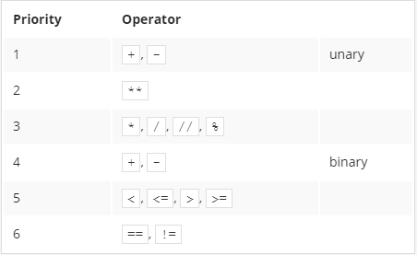
priority table

Slide 8
Making use of the answers
What can you do with the answer (i.e., the result of a comparison operation) you get from the computer?
There are at least two possibilities:
first, you can memorize it (store it in a variable) and make use of it later.
you can use the answer you get to make a decision about the future of the program.
Notes:
Making use of the answers
What can you do with the answer (i.e., the result of a comparison operation) you get from the computer?
There are at least two possibilities: first, you can memorize it (store it in a variable) and make use of it later. How do you do that? Well, you would use an arbitrary variable like this:
answer = number_of_lions >= number_of_lionesses The content of the variable will tell you the answer to the question asked.
The second possibility is more convenient and far more common: you can use the answer you get to make a decision about the future of the program.
You need a special instruction for this purpose, and we'll discuss it very soon.

Slide 9
LAB
Estimated time
5 minutes
Level of difficulty
Very Easy
Scenario
Using one of the comparison operators in Python, write a simple two-line program that takes the parameter n as input, which is an integer, and prints False if n is less than 100, and True if n is greater than or equal to 100.
Don't create any if blocks (we're going to talk about them very soon). Test your code using the data we've provided for you.
Test Data
Sample input: 55, 99, 100, 101 , -5 , +123
Notes:
Sample input: 55
Expected output: False
Sample input: 99
Expected output: False
Sample input: 100
Expected output: True
Sample input: 101
Expected output: True
Sample input: -5
Expected output: False
Sample input: +123
Expected output: True

Slide 10
Conditions and conditional execution
if true:
do this
This conditional statement consists of the following, strictly necessary, elements in this and this order only:
if keyword
one or more white spaces;
an expression (a question) whose value will be interpreted of True (when its value is non-zero) and False (when it is equal to zero);
a colon followed by a newline;
an indented instruction or set of instructions
the indentation may be achieved in two ways
by inserting a particular number of spaces (the recommendation is to use four spaces of indentation),
or by using the tab character
Notes:
Conditions and conditional execution
You already know how to ask Python questions, but you still don't know how to make reasonable use of the answers. You have to have a mechanism which will allow you to do something if a condition is met, and not do it if it isn't.
It's just like in real life: you do certain things or you don't when a specific condition is met or not, e.g., you go for a walk if the weather is good, or stay home if it's wet and cold.
To make such decisions, Python offers a special instruction. Due to its nature and its application, it's called a conditional instruction (or conditional statement).
There are several variants of it. We'll start with the simplest, increasing the difficulty slowly.
The first form of a conditional statement, which you can see below is written very informally but figuratively:
if true_or_not: do_this_if_true This conditional statement consists of the following, strictly necessary, elements in this and this order only:
the if keyword;
one or more white spaces;
an expression (a question or an answer) whose value will be interpreted solely in terms of True (when its value is non-zero) and False (when it is equal to zero);
a colon followed by a newline;
an indented instruction or set of instructions (at least one instruction is absolutely required); the indentation may be achieved in two ways - by inserting a particular number of spaces (the recommendation is to use four spaces of indentation), or by using the tab character;
note:
if there is more than one instruction in the indented part, the indentation should be the same in all lines; even though it may look the same if you use tabs mixed with spaces, it's important to make all indentations exactly the same - Python 3 does not allow mixing spaces and tabs for indentation.

Slide 11
If condition (more)
How does that statement work?
If the true_or_not expression represents the truth (i.e., its value is not equal to zero), the indented statement(s) will be executed;
if the true_or_not expression does not represent the truth (i.e., its value is equal to zero), the indented statement(s) will be omitted (ignored), and the next executed instruction will be the one after the original indentation level.
Notes:
How does that statement work?
If the true_or_not expression represents the truth (i.e., its value is not equal to zero), the indented statement(s) will be executed;
if the true_or_not expression does not represent the truth (i.e., its value is equal to zero), the indented statement(s) will be omitted (ignored), and the next executed instruction will be the one after the original indentation level.
In real life, we often express a desire:
if the weather is good, we'll go for a walk
then, we'll have lunch
As you can see, having lunch is not a conditional activity and doesn't depend on the weather.
Knowing what conditions influence our behavior, and assuming that we have the parameterless functions go_for_a_walk() and have_lunch(), we can write the following snippet:
if the_weather_is_good: go_for_a_walk() have_lunch()

Slide 12
Conditional execution: the if statement
if the weather is good:
take_a_shower()
go for a walk()
return_back_before_10()
Notes:
Conditonal execution: the if statement
If a certain sleepless Python developer falls asleep when he or she counts 120 sheep, and the sleep-inducing procedure may be implemented as a special function named sleep_and_dream(), the whole code takes the following shape:
if sheep_counter >= 120: # evaluate a test expression sleep_and_dream() # execute if test expression is True You can read it as: if sheep_counter is greater than or equal to 120, then fall asleep and dream (i.e., execute the sleep_and_dream function.)
We've said that conditionally executed statements have to be indented. This creates a very legible structure, clearly demonstrating all possible execution paths in the code.
Take a look at the following code:
if sheep_counter >= 120: make_a_bed() take_a_shower() sleep_and_dream() feed_the_sheepdogs() As you can see, making a bed, taking a shower and falling asleep and dreaming are all executed conditionally - when sheep_counter reaches the desired limit.
Feeding the sheepdogs, however, is always done (i.e., the feed_the_sheepdogs() function is not indented and does not belong to the if block, which means it is always executed.)
Now we're going to discuss another variant of the conditional statement, which also allows you to perform an additional action when the condition is not met.

Slide 13
Conditional execution: the if-else statement
if true_or_false_condition:
perform_if_condition_true (its value is not equal to zero)
else:
perform_if_condition_false (it is equal to zero)
Example
if the weather is good:
go for a walk()
else:
go to a theater()
return_back_before_10()
Notes:
Conditional execution: the if-else statement
We started out with a simple phrase which read: If the weather is good, we will go for a walk.
Note - there is not a word about what will happen if the weather is bad. We only know that we won't go outdoors, but what we could do instead is not known. We may want to plan something in case of bad weather, too.
We can say, for example: If the weather is good, we will go for a walk, otherwise we will go to a theater.
Now we know what we'll do if the conditions are met, and we know what we'll do if not everything goes our way. In other words, we have a "Plan B".
Python allows us to express such alternative plans. This is done with a second, slightly more complex form of the conditional statement, the if-else statement:
if true_or_false_condition: perform_if_condition_true else: perform_if_condition_false Thus, there is a new word: else - this is a keyword.
The part of the code which begins with else says what to do if the condition specified for the if is not met (note the colon after the word).
The if-else execution goes as follows:
if the condition evaluates to True (its value is not equal to zero), the perform_if_condition_true statement is executed, and the conditional statement comes to an end;
if the condition evaluates to False (it is equal to zero), the perform_if_condition_false statement is executed, and the conditional statement comes to an end.

Slide 14
The if-else statement: more conditional execution
Nested if-else statements
the instruction placed after the if is another if
Example
If the weather is fine:
go for a walk.
If we find a nice restaurant:
have lunch there.
else:
eat a sandwich.
else: (the weather is poor),
if tickets are available:
go to the theater
else: (there are no tickets)
go shopping in the nearest mall
Return_back_before_10
Notes:
The if-else statement: more conditional execution
By using this form of conditional statement, we can describe our plans as follows:
if the_weather_is_good: go_for_a_walk() else: go_to_a_theater() have_lunch() If the weather is good, we'll go for a walk. Otherwise, we'll go to a theatre. No matter if the weather is good or bad, we'll have lunch afterwards (after the walk or after going to the theatre).
Everything we've said about indentation works in the same manner inside the else branch:
if the_weather_is_good: go_for_a_walk() have_fun() else: go_to_a_theater() enjoy_the_movie() have_lunch() Nested if-else statements
Now let's discuss two special cases of the conditional statement.
First, consider the case where the instruction placed after the if is another if.
Read what we have planned for this Sunday. If the weather is fine, we'll go for a walk. If we find a nice restaurant, we'll have lunch there. Otherwise, we'll eat a sandwich. If the weather is poor, we'll go to the theater. If there are no tickets, we'll go shopping in the nearest mall.
Let's write the same in Python. Consider carefully the code here:
if the_weather_is_good: if nice_restaurant_is_found: have_lunch() else: eat_a_sandwich() else: if tickets_are_available: go_to_the_theater() else: go_shopping()

Slide 15
Here are two important points:
this use of the if statement is known as nesting;
remember that every else refers to the if which lies at the same indentation level; you need to know this to determine how the ifs and elses pair up;
consider how the indentation improves readability, and makes the code easier to understand and trace.
Notes:
Here are two important points:
this use of the if statement is known as nesting; remember that every else refers to the if which lies at the same indentation level; you need to know this to determine how the ifs and elses pair up;
consider how the indentation improves readability, and makes the code easier to understand and trace.

Slide 16
The elif statement
it's a shorter form of else if
elif is used to check more than just one condition, and to stop when the first statement which is true is found
Example
If the weather is fine:
go for a walk
elif we get tickets:
go to the theater
elif there are free tables at the restaurant:
go for lunch
else: (all fails)
return home and play chess
Notes:
The elif statement
The second special case introduces another new Python keyword: elif. As you probably suspect, it's a shorter form of else if.
elif is used to check more than just one condition, and to stop when the first statement which is true is found.
Our next example resembles nesting, but the similarities are very slight. Again, we'll change our plans and express them as follows: If the weather is fine, we'll go for a walk, otherwise if we get tickets, we'll go to the theater, otherwise if there are free tables at the restaurant, we'll go for lunch; if all else fails, we'll return home and play chess.
Have you noticed how many times we've used the word otherwise? This is the stage where the elif keyword plays its role.
Let's write the same scenario using Python:
if the_weather_is_good go_for_a_walk() elif tickets_are_available: go_to_the_theater() elif table_is_available: go_for_lunch() else: play_chess_at_home()

Slide 17
Pay attention
The way to assemble subsequent if-elif-else statements is sometimes called a cascade.
you mustn't use else without a preceding if
else is always the last branch of the cascade, regardless of whether you've used elif or not;
else is an optional part of the cascade, and may be omitted;
if there is an else branch in the cascade, only one of all the branches is executed;
if there is no else branch, it's possible that none of the available branches is executed.
Notes:
Notice again how the indentation improves the readability of the code.
Some additional attention has to be paid in this case:
This may sound a little puzzling, but hopefully some simple examples will help shed more light.

Slide 18
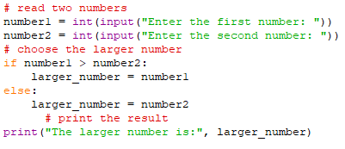

Example 1:
find the largest of several numbers and print it out
Notes:
Analyzing code samples
Now we're going to show you some simple yet complete programs. We won't explain them in detail, because we consider the comments (and the variable names) inside the code to be sufficient guides.
All the programs solve the same problem - they find the largest of several numbers and print it out.

Slide 19
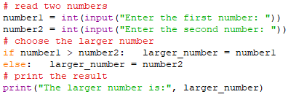
Example 2:
if any of the if-elif-else branches contains just one instruction, you may code it in a more comprehensive form (you don't need to make an indented line after the keyword, but just continue the line after the colon)
Notes:
Now we're going to show you one intriguing fact. Python has an interesting feature, look at the code below:
Note: if any of the if-elif-else branches contains just one instruction, you may code it in a more comprehensive form (you don't need to make an indented line after the keyword, but just continue the line after the colon).
This style, however, may be misleading, and we're not going to use it in our future programs, but it's definitely worth knowing if you want to read and understand someone else's programs.
There are no other differences in the code.

Slide 20
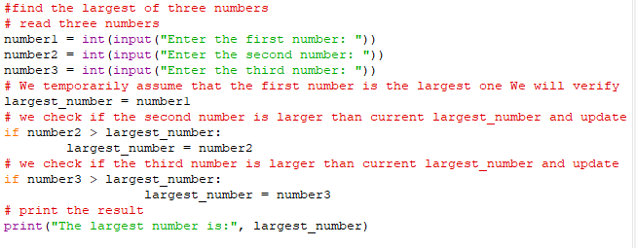

Example 3:
find the largest of three numbers
Notes:
Example 3:
It's time to complicate the code - let's find the largest of three numbers. Will it enlarge the code? A bit.
We assume that the first value is the largest. Then we verify this hypothesis with the two remaining values.
Look at the code below:
# read three numbers number1 = int(input("Enter the first number: ")) number2 = int(input("Enter the second number: ")) number3 = int(input("Enter the third number: ")) # We temporarily assume that the first number # is the largest one. # We will verify this soon. largest_number = number1 # we check if the second number is larger than current largest_number # and update largest_number if needed if number2 > largest_number: largest_number = number2 # we check if the third number is larger than current largest_number # and update largest_number if needed if number3 > largest_number: largest_number = number3 # print the result print("The largest number is:", largest_number) This method is significantly simpler than trying to find the largest number all at once, by comparing all possible pairs of numbers (i.e., first with second, second with third, third with first). Try to rebuild the code for yourself.
largest_number = max(number1, number2, number3)

Slide 21
LAB
Estimated time
5-10 minutes
Level of difficulty
Easy
Scenario
Spathiphyllum, more commonly known as a peace lily or white sail plant, is one of the most popular indoor houseplants that filters out harmful toxins from the air. Some of the toxins that it neutralizes include benzene, formaldehyde, and ammonia.
Imagine that your computer program loves these plants. Whenever it receives an input in the form of the word Spathiphyllum, it involuntarily shouts to the console the following string: "Spathiphyllum is the best plant ever!"
Write a program that utilizes the concept of conditional execution, takes a string as input, and:
prints the sentence "Yes - Spathiphyllum is the best plant ever!" to the screen if the inputted string is "Spathiphyllum" (upper-case)
prints "No, I want a big Spathiphyllum!" if the inputted string is "spathiphyllum" (lower-case)
prints "Spathiphyllum! Not [input]!" otherwise. Note: [input] is the string taken as input.
Test your code using the data we've provided for you. And get yourself a Spathiphyllum, too!
Notes:
LAB Estimated time
5-10 minutes
Level of difficulty
Easy
Objectives
becoming familiar with the the input() function;
becoming familiar with comparison operators in Python;
becoming familiar with the concept of conditional execution.
Scenario
Spathiphyllum, more commonly known as a peace lily or white sail plant, is one of the most popular indoor houseplants that filters out harmful toxins from the air. Some of the toxins that it neutralizes include benzene, formaldehyde, and ammonia.
Imagine that your computer program loves these plants. Whenever it receives an input in the form of the word Spathiphyllum, it involuntarily shouts to the console the following string: "Spathiphyllum is the best plant ever!"
Write a program that utilizes the concept of conditional execution, takes a string as input, and:
prints the sentence "Yes - Spathiphyllum is the best plant ever!" to the screen if the inputted string is "Spathiphyllum" (upper-case)
prints "No, I want a big Spathiphyllum!" if the inputted string is "spathiphyllum" (lower-case)
prints "Spathiphyllum! Not [input]!" otherwise. Note: [input] is the string taken as input.
Test your code using the data we've provided for you. And get yourself a Spathiphyllum, too!
Test Data
Sample input: spathiphyllum
Expected output: No, I want a big Spathiphyllum!
Sample input: pelargonium
Expected output: Spathiphyllum! Not pelargonium!
Sample input: Spathiphyllum
Expected output: Yes - Spathiphyllum is the best plant ever!

Slide 22
LAB
Estimated time
10-15 minutes
Level of difficulty
Easy/Medium
Scenario
Once upon a time there was a land - a land of milk and honey, inhabited by happy and prosperous people. The people paid taxes, of course - their happiness had limits. The most important tax, called the Personal Income Tax (PIT for short) had to be paid once a year, and was evaluated using the following rule:
if the citizen's income was not higher than 85,528 thalers, the tax was equal to 18% of the income minus 556 thalers and 2 cents (this was the so-called tax relief)
if the income was higher than this amount, the tax was equal to 14,839 thalers and 2 cents, plus 32% of the surplus over 85,528 thalers.
Your task is to write a tax calculator.
It should accept one floating-point value: the income.
Next, it should print the calculated tax, rounded to full thalers. There's a function named round() which will do the rounding for you - you'll find it in the skeleton code in the editor.
Note: this happy country never returns money to its citizens. If the calculated tax is less than zero, it only means no tax at all (the tax is equal to zero). Take this into consideration during your calculations.
Look at the code in the editor - it only reads one input value and outputs a result, so you need to complete it with some smart calculations.
Test your code using the data we've provided.
Notes:
LAB Estimated time
10-15 minutes
Level of difficulty
Easy/Medium
Objectives
Familiarize the student with:
using the if-else instruction to branch the control path;
building a complete program that solves simple real-life problems.
Scenario
Once upon a time there was a land - a land of milk and honey, inhabited by happy and prosperous people. The people paid taxes, of course - their happiness had limits. The most important tax, called the Personal Income Tax (PIT for short) had to be paid once a year, and was evaluated using the following rule:
if the citizen's income was not higher than 85,528 thalers, the tax was equal to 18% of the income minus 556 thalers and 2 cents (this was the so-called tax relief)
if the income was higher than this amount, the tax was equal to 14,839 thalers and 2 cents, plus 32% of the surplus over 85,528 thalers.
Your task is to write a tax calculator.
It should accept one floating-point value: the income.
Next, it should print the calculated tax, rounded to full thalers. There's a function named round() which will do the rounding for you - you'll find it in the skeleton code in the editor.
Note: this happy country never returns money to its citizens. If the calculated tax is less than zero, it only means no tax at all (the tax is equal to zero). Take this into consideration during your calculations.
Look at the code in the editor - it only reads one input value and outputs a result, so you need to complete it with some smart calculations.
Test your code using the data we've provided.
Test Data
Sample input: 10000
Expected output: The tax is: 1244.0 thalers
Sample input: 100000
Expected output: The tax is: 19470.0 thalers
Sample input: 1000
Expected output: The tax is: 0.0 thalers
Sample input: -100
Expected output: The tax is: 0.0 thalers

Slide 23
LAB
Estimated time
10-15 minutes
Level of difficulty
Easy/Medium
Scenario
As you surely know, due to some astronomical reasons, years may be leap or common. The former are 366 days long, while the latter are 365 days long.
Since the introduction of the Gregorian calendar (in 1582), the following rule is used to determine the kind of year:
if the year number isn't divisible by four, it's a common year;
otherwise, if the year number isn't divisible by 100, it's a leap year;
otherwise, if the year number isn't divisible by 400, it's a common year;
otherwise, it's a leap year.
Look at the code in the editor - it only reads a year number, and needs to be completed with the instructions implementing the test we've just described.
The code should output one of two possible messages, which are Leap year or Common year, depending on the value entered.
It would be good to verify if the entered year falls into the Gregorian era, and output a warning otherwise: Not within the Gregorian calendar period. Tip: use the != and % operators.
Test your code using the data we've provided.
Notes:
LAB Estimated time
10-15 minutes
Level of difficulty
Easy/Medium
Objectives
Familiarize the student with:
using the if-elif-else statement;
finding the proper implementation of verbally defined rules;
testing code using sample input and output.
Scenario
As you surely know, due to some astronomical reasons, years may be leap or common. The former are 366 days long, while the latter are 365 days long.
Since the introduction of the Gregorian calendar (in 1582), the following rule is used to determine the kind of year:
if the year number isn't divisible by four, it's a common year;
otherwise, if the year number isn't divisible by 100, it's a leap year;
otherwise, if the year number isn't divisible by 400, it's a common year;
otherwise, it's a leap year.
Look at the code in the editor - it only reads a year number, and needs to be completed with the instructions implementing the test we've just described.
The code should output one of two possible messages, which are Leap year or Common year, depending on the value entered.
It would be good to verify if the entered year falls into the Gregorian era, and output a warning otherwise: Not within the Gregorian calendar period. Tip: use the != and % operators.
Test your code using the data we've provided.
Test Data
Sample input: 2000
Expected output: Leap year
Sample input: 2015
Expected output: Common year
Sample input: 1999
Expected output: Common year
Sample input: 1996
Expected output: Leap year
Sample input: 1580
Expected output: Not within the Gregorian calendar period

Slide 24
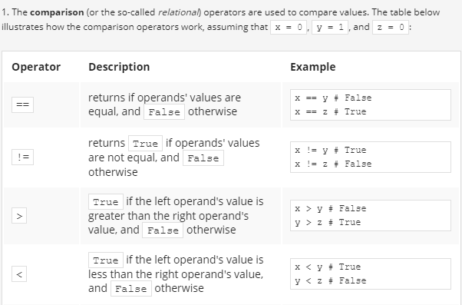
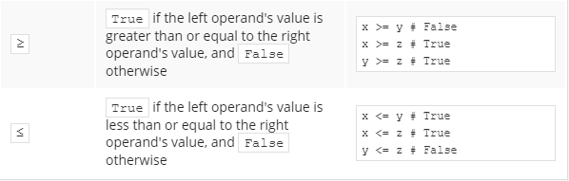
Operators Priorities

Slide 25
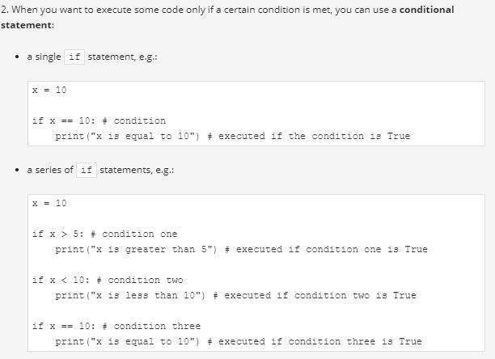

Slide 26
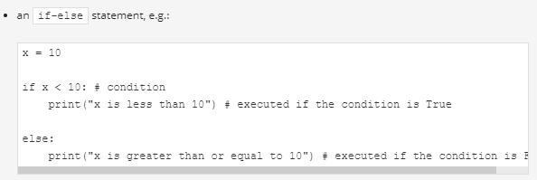
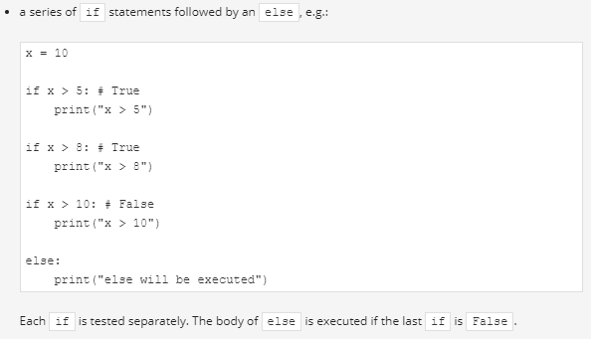

Slide 27
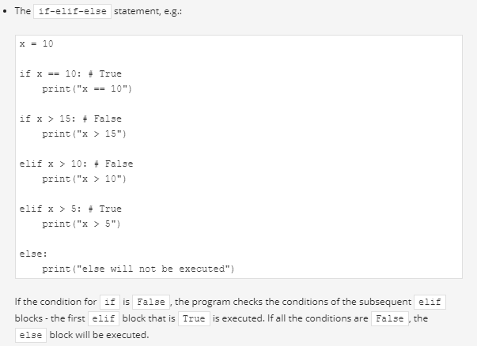

Slide 28
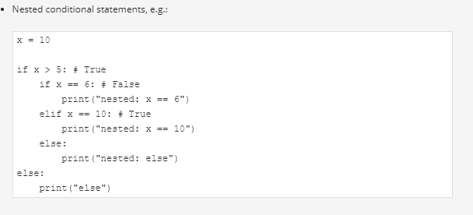

Slide 29
Exercises
Exercise 1
What is the output of the following snippet?
x = 5 y = 10 z = 8
print(x > y)
print(y > z)
Exercise 2
What is the output of the following snippet?
x, y, z = 5, 10, 8 print(x > z) print((y - 5) == x)
Notes:
Exercise 1
What is the output of the following snippet?
x = 5 y = 10 z = 8 print(x > y) print(y > z)
False True
Exercise 2
What is the output of the following snippet?
x, y, z = 5, 10, 8 print(x > z) print((y - 5) == x) CheckFalse True

Slide 30
Exercises
Exercise 3
What is the output of the following snippet?
x, y, z = 5, 10, 8
x, y, z = z, y, x
print(x > z) print((y - 5) == x)
Exercise 4
What is the output of the following snippet?
x = 10 if x == 10: print(x == 10) if x > 5: print(x > 5) if x < 10: print(x < 10) else: print("else")
Notes:
Exercise 3
What is the output of the following snippet?
x, y, z = 5, 10, 8 x, y, z = z, y, x print(x > z) print((y - 5) == x) CheckTrue False
Exercise 4
What is the output of the following snippet?
x = 10 if x == 10: print(x == 10) if x > 5: print(x > 5) if x < 10: print(x < 10) else: print("else") CheckTrue True else

Slide 31
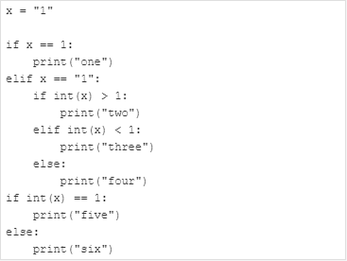
Exercise 5 What is the output of the following snippet?
Notes:
Exercise 5
What is the output of the following snippet?
x = "1" if x == 1: print("one") elif x == "1": if int(x) > 1: print("two") elif int(x) < 1: print("three") else: print("four") if int(x) == 1: print("five") else: print("six") Check four five

Slide 32
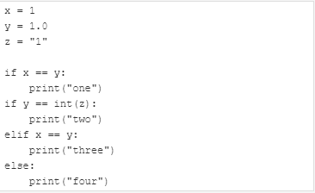
Exercise 6 What is the output of the following snippet?
Notes:
x = 1 y = 1.0 z = "1" if x == y: print("one") if y == int(z): print("two") elif x == y: print("three") else: print("four") Check one two

Slide 33
Looping your code with while
while conditional_expression:
Instruction
the syntactic difference between while and if is only one: you use the word while instead of the word if
The semantic difference is more important: when the condition is met, if performs its statements only once; while repeats the execution as long as the condition evaluates to True.
all the rules regarding indentation are applicable here, too. We'll show you this soon.
Notes:
If you notice some similarities to the if instruction, that's quite all right. Indeed, the syntactic difference is only one: you use the word while instead of the word if.
The semantic difference is more important: when the condition is met, if performs its statements only once; while repeats the execution as long as the condition evaluates to True.
Note: all the rules regarding indentation are applicable here, too. We'll show you this soon.

Slide 34
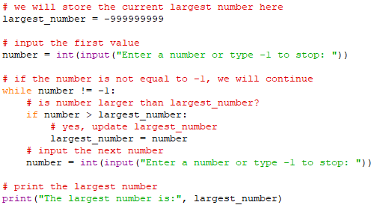
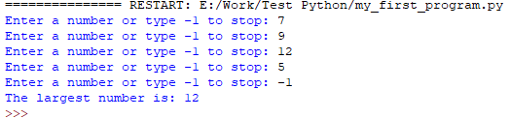
Example
Notes:
# we will store the current largest number here
largest_number = -999999999
# input the first value
number = int(input("Enter a number or type -1 to stop: "))
# if the number is not equal to -1, we will continue
while number != -1:
# is number larger than largest_number?
if number > largest_number:
# yes, update largest_number
largest_number = number
# input the next number
number = int(input("Enter a number or type -1 to stop: "))
# print the largest number
print("The largest number is:", largest_number)

Slide 35

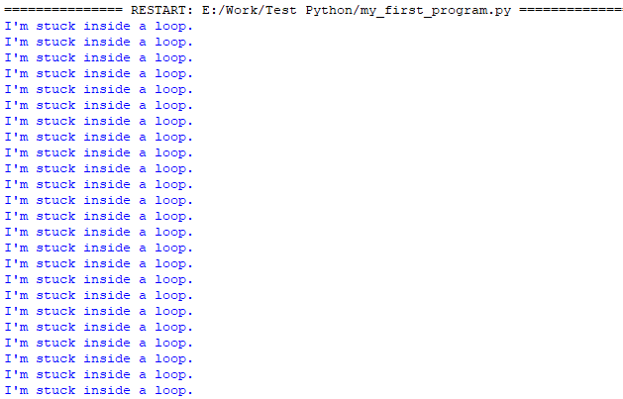
An infinite loop
An infinite loop, also called an endless loop, is a sequence of instructions in a program which repeat indefinitely (loop endlessly.)
while True:
print("I'm stuck inside a loop.")
To terminate your program, just press Ctrl-C (or Ctrl-Break on some computers).
Notes:
An infinite loop
An infinite loop, also called an endless loop, is a sequence of instructions in a program which repeat indefinitely (loop endlessly.)
Here's an example of a loop that is not able to finish its execution:
while True:
print("I'm stuck inside a loop.") This loop will infinitely print "I'm stuck inside a loop." on the screen.
If you want to get the best learning experience from seeing how an infinite loop behaves, launch IDLE, create a New File, copy-paste the above code, save your file, and run the program. What you will see is the never-ending sequence of "I'm stuck inside a loop." strings printed to the Python console window. To terminate your program, just press Ctrl-C (or Ctrl-Break on some computers). This will cause the so-called KeyboardInterrupt exception and let your program get out of the loop. We'll talk about it later in the course.
Let's go back to the sketch of the algorithm we showed you recently. We're going to show you how to use this newly learned loop to find the largest number from a large set of entered data.
Analyze the program carefully. Locate the loop's body and find out how the body is exited:
Check how this code implements the algorithm we showed you earlier.

Slide 36
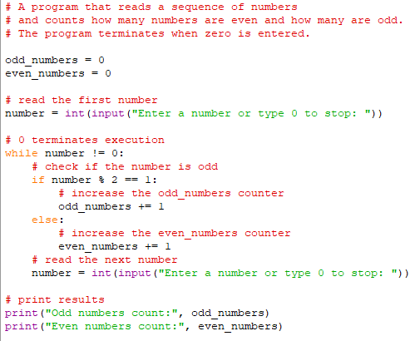
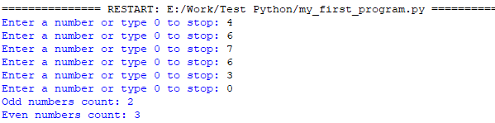
The while loop: more examples
Notes:
Let's look at another example employing the while loop. Follow the comments to find out the idea and the solution.
# A program that reads a sequence of numbers
# and counts how many numbers are even and how many are odd.
# The program terminates when zero is entered.
odd_numbers = 0
even_numbers = 0
# read the first number
number = int(input("Enter a number or type 0 to stop: "))
# 0 terminates execution
while number != 0:
# check if the number is odd
if number % 2 == 1:
# increase the odd_numbers counter
odd_numbers += 1
else:
# increase the even_numbers counter
even_numbers += 1
# read the next number
number = int(input("Enter a number or type 0 to stop: "))
# print results
print("Odd numbers count:", odd_numbers)
print("Even numbers count:", even_numbers)

Slide 37

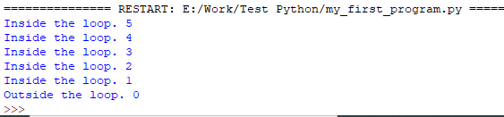

Using a counter variable to exit a loop
Notes:
counter = 5
while counter != 0:
print("Inside the loop.", counter)
counter -= 1
print("Outside the loop.", counter)
counter = 5
while counter :
print("Inside the loop.", counter)
counter -= 1
print("Outside the loop.", counter)

Slide 38
LAB Estimated time
15 minutes
Level of difficulty
Easy
Objectives
Familiarize the student with:
using the while loop;
reflecting real-life situations in computer code.
Scenario
A junior magician has picked a secret number. He has hidden it in a variable named secret_number. He wants everyone who run his program to play the Guess the secret number game, and guess what number he has picked for them. Those who don't guess the number will be stuck in an endless loop forever! Unfortunately, he does not know how to complete the code.

Slide 39
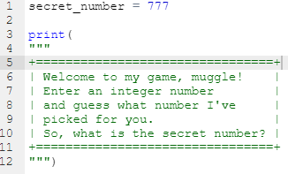
Your task is to help the magician complete the code in the editor in such a way so that the code:
will ask the user to enter an integer number;
will use a while loop;
will check whether the number entered by the user is the same as the number picked by the magician. If the number chosen by the user is different than the magician's secret number, the user should see the message "Ha ha! You're stuck in my loop!" and be prompted to enter a number again. If the number entered by the user matches the number picked by the magician, the number should be printed to the screen, and the magician should say the following words: "Well done, muggle! You are free now."
The magician is counting on you! Don't disappoint him.
Notes:
Your task is to help the magician complete the code in the editor in such a way so that the code:
will ask the user to enter an integer number;
will use a while loop;
will check whether the number entered by the user is the same as the number picked by the magician. If the number chosen by the user is different than the magician's secret number, the user should see the message "Ha ha! You're stuck in my loop!" and be prompted to enter a number again. If the number entered by the user matches the number picked by the magician, the number should be printed to the screen, and the magician should say the following words: "Well done, muggle! You are free now."
The magician is counting on you! Don't disappoint him.

Slide 40


Looping your code with for
Another kind of loop available in Python comes from the observation that sometimes it's more important to count the "turns" of the loop than to check the conditions.
You can do it with while, can’t you?

Slide 41
Looping your code with for
the for keyword opens the for loop; note - there's no condition after it; you don't have to think about conditions, as they're checked internally, without any intervention;
any variable after the for keyword is the control variable of the loop; it counts the loop's turns, and does it automatically;
the in keyword introduces a syntax element describing the range of possible values being assigned to the control variable;
the range() function is responsible for generating all the desired values of the control variable; note the pass keyword inside the loop body - it does nothing at all; it's an empty instruction - we put it here because the for loop's syntax demands at least one instruction inside the body
Notes:
the for keyword opens the for loop; note - there's no condition after it; you don't have to think about conditions, as they're checked internally, without any intervention;
any variable after the for keyword is the control variable of the loop; it counts the loop's turns, and does it automatically;
the in keyword introduces a syntax element describing the range of possible values being assigned to the control variable;
the range() function (this is a very special function) is responsible for generating all the desired values of the control variable; in our example, the function will create (we can even say that it will feed the loop with) subsequent values from the following set: 0, 1, 2 .. 97, 98, 99; note: in this case, the range() function starts its job from 0 and finishes it one step (one integer number) before the value of its argument;
note the pass keyword inside the loop body - it does nothing at all; it's an empty instruction - we put it here because the for loop's syntax demands at least one instruction inside the body (by the way - if, elif, else and while express the same thing)

Slide 42
Examples
Note:
the loop has been executed ten times (it's the range() function's argument)
the last control variable's value is 9 (not 10, as it starts from 0, not from 1)
In this case, the first argument determines the initial (first) value of the control variable.
The last argument shows the first value the control variable will not be assigned.
Note: the range() function accepts only integers as its arguments, and generates sequences of integers.
Notes:
Can you guess the output of the program? Run it to check if you were right now, too.
The first value shown is 2 (taken from the range()'s first argument.)
The last is 7 (although the range()'s second argument is 8).
for i in range(10):
print("The value of i is currently", i)
for i in range(2, 8):
print("The value of i is currently", i)

Slide 43

More examples
The third argument is an increment - it's a value added to control the variable at every loop turn (as you may suspect, the default value of the increment is 1).
if the set generated by the range() function is empty, the loop won't execute its body at all.
the set generated by the range() has to be sorted in ascending order. There's no way to force the range() to create a set in a different form. This means that the range()'s second argument must be greater than the first.
Notes:
The third argument is an increment - it's a value added to control the variable at every loop turn (as you may suspect, the default value of the increment is 1).
The first argument passed to the range() function tells us what the starting number of the sequence is (hence 2 in the output). The second argument tells the function where to stop the sequence (the function generates numbers up to the number indicated by the second argument, but does not include it). Finally, the third argument indicates the step, which actually means the difference between each number in the sequence of numbers generated by the function.
Note: if the set generated by the range() function is empty, the loop won't execute its body at all.
Just like here - there will be no output:
Note: the set generated by the range() has to be sorted in ascending order. There's no way to force the range() to create a set in a different form. This means that the range()'s second argument must be greater than the first.
Thus, there will be no output here, either:
for i in range(2, 8,3):
print("The value of i is currently", i)
for i in range(1, 1):
print("The value of i is currently", i)
for i in range(2, 1):
print("The value of i is currently", i)

Slide 44

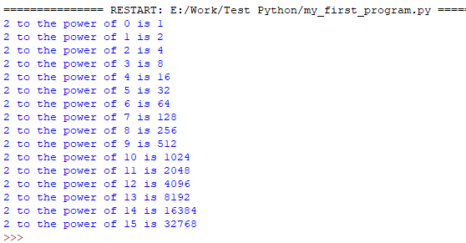
More examples
Notes:
The exp variable is used as a control variable for the loop, and indicates the current value of the exponent. The exponentiation itself is replaced by multiplying by two. Since 2⁰ is equal to 1, then 2 × 1 is equal to 2¹, 2 × 2¹ is equal to 2², and so on. What is the greatest exponent for which our program still prints the result?
Run the code and check if the output matches your expectations.
pow = 1
for exp in range(16):
print("2 to the power of", exp, "is", pow)
pow *= 2

Slide 45
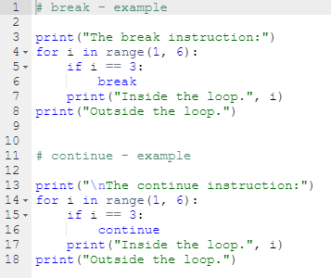
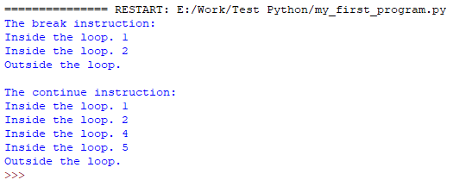
The break and continue statements
Notes:
So far, we've treated the body of the loop as an indivisible and inseparable sequence of instructions that are performed completely at every turn of the loop. However, as developer, you could be faced with the following choices:
it appears that it's unnecessary to continue the loop as a whole; you should refrain from further execution of the loop's body and go further;
it appears that you need to start the next turn of the loop without completing the execution of the current turn.
Python provides two special instructions for the implementation of both these tasks. Let's say for the sake of accuracy that their existence in the language is not necessary - an experienced programmer is able to code any algorithm without these instructions. Such additions, which don't improve the language's expressive power, but only simplify the developer's work, are sometimes called syntactic candy, or syntactic sugar.
These two instructions are:
break - exits the loop immediately, and unconditionally ends the loop's operation; the program begins to execute the nearest instruction after the loop's body;
continue - behaves as if the program has suddenly reached the end of the body; the next turn is started and the condition expression is tested immediately.
Both these words are keywords.
Now we'll show you two simple examples to illustrate how the two instructions work. Look at the code in the editor. Run the program and analyze the output. Modify the code and experiment.
# break - example
print("The break instruction:")
for i in range(1, 6):
if i == 3:
break
print("Inside the loop.", i)
print("Outside the loop.")
# continue - example
print("\nThe continue instruction:")
for i in range(1, 6):
if i == 3:
continue
print("Inside the loop.", i)
print("Outside the loop.")

Slide 46
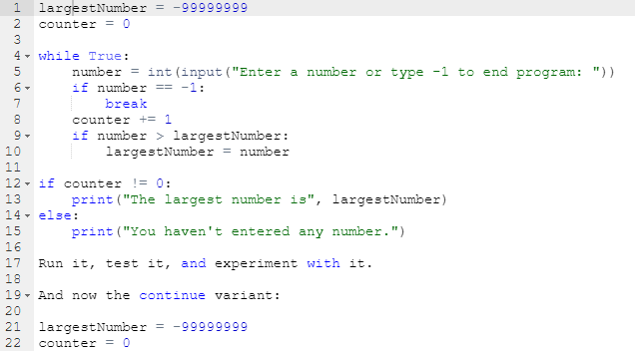
The break statement: more examples
Notes:
largestNumber = -99999999
counter = 0
while True:
number = int(input("Enter a number or type -1 to end program: "))
if number == -1:
break
counter += 1
if number > largestNumber:
largestNumber = number
if counter != 0:
print("The largest number is", largestNumber)
else:
print("You haven't entered any number.")

Slide 47
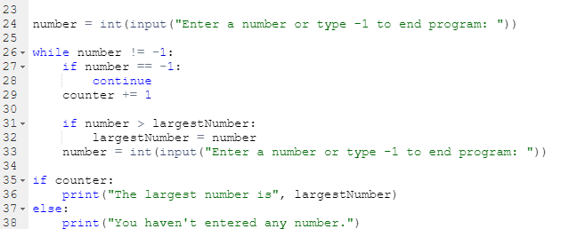
The continue statement: more examples
Notes:
largestNumber = -99999999
counter = 0
number = int(input("Enter a number or type -1 to end program: "))
while number != -1:
if number == -1:
continue
counter += 1
if number > largestNumber:
largestNumber = number
number = int(input("Enter a number or type -1 to end program: "))
if counter:
print("The largest number is", largestNumber)
else:
print("You haven't entered any number.")

Slide 48
LAB
Estimated time
10 minutes
Level of difficulty
Easy
Objectives
Familiarize the student with:
using the break statement in loops;
reflecting real-life situations in computer code.
Scenario
The break statement is used to exit/terminate a loop.
Design a program that uses a while loop and continuously asks the user to enter a word unless the user enters "chupacabra" as the secret exit word, in which case the message "You've successfully left the loop." should be printed to the screen, and the loop should terminate.
Don't print any of the words entered by the user. Use the concept of conditional execution and the break statement.
Notes:
LAB Estimated time
10 minutes
Level of difficulty
Easy
Objectives
Familiarize the student with:
using the break statement in loops;
reflecting real-life situations in computer code.
Scenario
The break statement is used to exit/terminate a loop.
Design a program that uses a while loop and continuously asks the user to enter a word unless the user enters "chupacabra" as the secret exit word, in which case the message "You've successfully left the loop." should be printed to the screen, and the loop should terminate.
Don't print any of the words entered by the user. Use the concept of conditional execution and the break statement.

Slide 49
Estimated time
10-15 minutes
Level of difficulty
Easy
Objectives
Familiarize the student with:
using the continue statement in loops;
reflecting real-life situations in computer code.
Scenario
The continue statement is used to skip the current block and move ahead to the next iteration, without executing the statements inside the loop.
It can be used with both the while and for loops.
Your task here is very special: you must design a vowel eater! Write a program that uses:
a for loop;
the concept of conditional execution (if-elif-else)
the continue statement.
Your program must:
ask the user to enter a word;
use userWord = userWord.upper() to convert the word entered by the user to upper case; we'll talk about the so-called string methods and the upper() method very soon - don't worry;
use conditional execution and the continue statement to "eat" the following vowels A, E, I, O, U from the inputted word;
print the uneaten letters to the screen, each one of them on a separate line.
Test your program with the data we've provided for you.
Notes:
Test data
Sample input: Gregory
Expected output:
G R G R YSample input: abstemious
Expected output:
B S T M SSample input: IOUEA
Expected output:

Slide 50
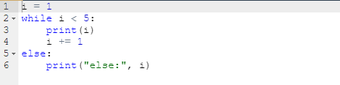
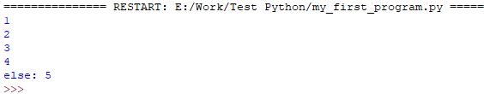
The while loop and the else branch
Notes:
Both loops, while and for, have one interesting (and rarely used) feature.
We'll show you how it works - try to judge for yourself if it's usable and whether you can live without it or not.
In other words, try to convince yourself if the feature is valuable and useful, or is just syntactic sugar.
Take a look at the snippet in the editor. There's something strange at the end - the else keyword.
As you may have suspected, loops may have the else branch too, like ifs.
The loop's else branch is always executed once, regardless of whether the loop has entered its body or not.
Can you guess the output? Run the program to check if you were right.
Modify the snippet a bit so that the loop has no chance to execute its body even once:
i = 5
while i < 5:
print(i)
i += 1
else:
print("else:", i) The while's condition is False at the beginning - can you see it?
Run and test the program, and check whether the else branch has been executed or not.
i = 1
while i < 5:
print(i)
i += 1
else:
print("else:", i)
i = 5
while i < 5:
print(i)
i += 1
else:
print("else:", i)

Slide 51


The for loop and the else branch
Notes:
The for loop and the else branch
for loops behave a bit differently - take a look at the snippet in the editor and run it.
The output may be a bit surprising.
The i variable retains its last value.
Modify the code a bit to carry out one more experiment.
i = 111 for i in range(2, 1): print(i) else: print("else:", i) Can you guess the output?
The loop's body won't be executed here at all. Note: we've assigned the i variable before the loop.
Run the program and check its output.
When the loop's body isn't executed, the control variable retains the value it had before the loop.
Note: if the control variable doesn't exist before the loop starts, it won't exist when the execution reaches the else branch.
How do you feel about this variant of else?
Now we're going to tell you about some other kinds of variables. Our current variables can only store one value at a time, but there are variables that can do much more - they can store as many values as you want.
for i in range(5):
print(i)
else:
print("else:", i)

Slide 52
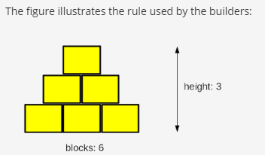
LAB
Notes:
Estimated time
20-30 minutes
Level of difficulty
Medium
Objectives
Familiarize the student with:
using the while loop;
finding the proper implementation of verbally defined rules;
reflecting real-life situations in computer code.
Scenario
Listen to this story: a boy and his father, a computer programmer, are playing with wooden blocks. They are building a pyramid.
Their pyramid is a bit weird, as it is actually a pyramid-shaped wall - it's flat. The pyramid is stacked according to one simple principle: each lower layer contains one block more than the layer above.
The figure illustrates the rule used by the builders:
Your task is to write a program which reads the number of blocks the builders have, and outputs the height of the pyramid that can be built using these blocks.
Note: the height is measured by the number of fully completed layers - if the builders don't have a sufficient number of blocks and cannot complete the next layer, they finish their work immediately.
Test your code using the data we've provided.
Test Data
Sample input: 6
Expected output: The height of the pyramid: 3
Sample input: 20
Expected output: The height of the pyramid: 5
Sample input: 1000
Expected output: The height of the pyramid: 44
Sample input: 2
Expected output: The height of the pyramid: 1

Slide 53
LAB
Estimated time
20 minutes
Level of difficulty
Medium
Objectives
Familiarize the student with:
using the while loop;
converting verbally defined loops into actual Python code.
Scenario
In 1937, a German mathematician named Lothar Collatz formulated an intriguing hypothesis (it still remains unproven) which can be described in the following way:
take any non-negative and non-zero integer number and name it c0;
if it's even, evaluate a new c0 as c0 ÷ 2;
otherwise, if it's odd, evaluate a new c0 as 3 × c0 + 1;
if c0 ≠ 1, skip to point 2.
The hypothesis says that regardless of the initial value of c0, it will always go to 1.
Of course, it's an extremely complex task to use a computer in order to prove the hypothesis for any natural number (it may even require artificial intelligence), but you can use Python to check some individual numbers. Maybe you'll even find the one which would disprove the hypothesis.
Write a program which reads one natural number and executes the above steps as long as c0 remains different from 1. We also want you to count the steps needed to achieve the goal. Your code should output all the intermediate values of c0, too.
Hint: the most important part of the problem is how to transform Collatz's idea into a while loop - this is the key to success.
Test your code using the data we've provided.
Notes:
LAB Estimated time
20 minutes
Level of difficulty
Medium
Objectives
Familiarize the student with:
using the while loop;
converting verbally defined loops into actual Python code.
Scenario
In 1937, a German mathematician named Lothar Collatz formulated an intriguing hypothesis (it still remains unproven) which can be described in the following way:
take any non-negative and non-zero integer number and name it c0;
if it's even, evaluate a new c0 as c0 ÷ 2;
otherwise, if it's odd, evaluate a new c0 as 3 × c0 + 1;
if c0 ≠ 1, skip to point 2.
The hypothesis says that regardless of the initial value of c0, it will always go to 1.
Of course, it's an extremely complex task to use a computer in order to prove the hypothesis for any natural number (it may even require artificial intelligence), but you can use Python to check some individual numbers. Maybe you'll even find the one which would disprove the hypothesis.
Write a program which reads one natural number and executes the above steps as long as c0 remains different from 1. We also want you to count the steps needed to achieve the goal. Your code should output all the intermediate values of c0, too.
Hint: the most important part of the problem is how to transform Collatz's idea into a while loop - this is the key to success.
Test your code using the data we've provided.
Test Data
Sample input: 15
Expected output:
46 23 70 35 106 53 160 80 40 20 10 5 16 8 4 2 1 steps = 17Sample input: 16
Expected output:
8 4 2 1 steps = 4Sample input: 1023
Expected output:
3070 1535 4606 2303 6910 3455 10366 5183 15550 7775 23326 11663 34990 17495 52486 26243 78730 39365 118096 59048 29524 14762 7381 22144 11072 5536 2768 1384 692 346 173 520 260 130 65 196 98 49 148 74 37 112 56 28 14 7 22 11 34 17 52 26 13 40 20 10 5 16 8 4 2 1 steps = 62

Slide 54
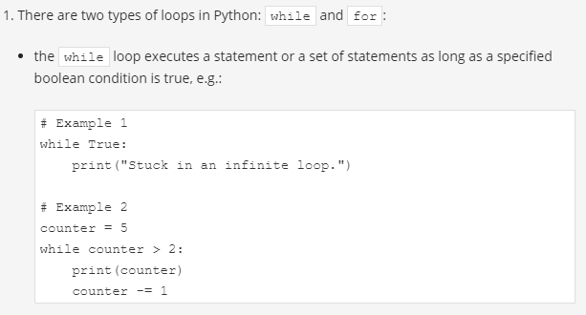

Slide 55
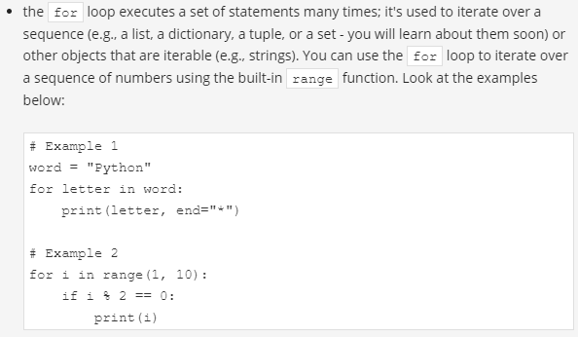

Slide 56
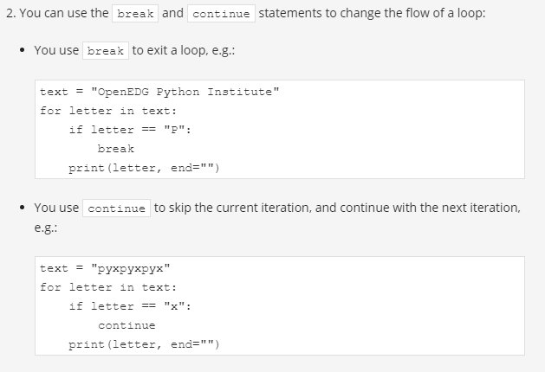

Slide 57
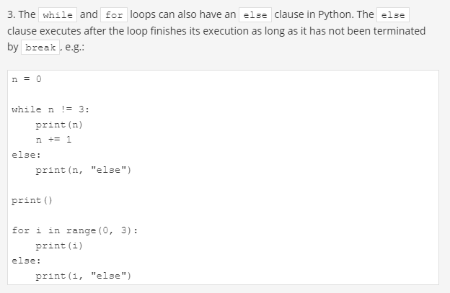

Slide 58
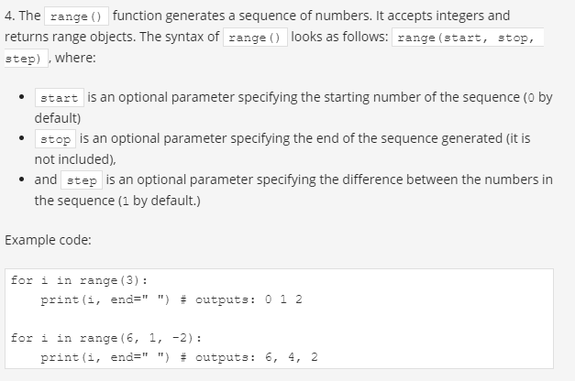

Slide 59
Exercise 1
Create a for loop that counts from 0 to 10, and prints odd numbers to the screen. Use the skeleton below:
Exercise 2
Create a while loop that counts from 0 to 10, and prints odd numbers to the screen. Use the skeleton below:
Exercise 3
Create a program with a for loop and a break statement. The program should iterate over characters in an email address, exit the loop when it reaches the @ symbol, and print the part before @ on one line. Use the skeleton below:
for ch in "john.smith@pythoninstitute.org":
if ch == "@":
# line of code
# line of code
Notes:
Sample solution: for i in range(0, 11): if i % 2 != 0: print(i)
Sample solution: x = 1 while x < 11: if x % 2 != 0: print(x) x += 1
CheckSample solution: for ch in "john.smith@pythoninstitute.org": if ch == "@": break print(ch, end="")

Slide 60
Exercise 4
Create a program with a for loop and a continue statement. The program should iterate over a string of digits, replace each 0 with x, and print the modified string to the screen. Use the skeleton below:
for digit in "0165031806510":
if digit == "0":
# line of code
# line of code
# line of code
Notes:
CheckSample solution: for digit in "0165031806510": if digit == "0": print("x", end="") continue print(digit, end="")

Slide 61
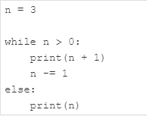
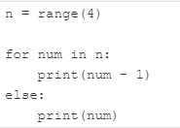

Exercise 5
What is the output of the following codes?
Notes:
Exercise 5
What is the output of the following code?
n = 3 while n > 0: print(n + 1) n -= 1 else: print(n) Check4 3 2 0
Exercise 6
What is the output of the following code?
n = range(4) for num in n: print(num - 1) else: print(num) Check-1 0 1 2 3
Exercise 7
What is the output of the following code?
for i in range(0, 6, 3): print(i) Check0 3

Slide 62
Computer logic
If we have some free time,
we will go for a walk.
If we have some free time, and the weather is good,
we will go for a walk.
Conjunction & disjunction.
Notes:
Computer logic
Have you noticed that the conditions we've used so far have been very simple, not to say, quite primitive? The conditions we use in real life are much more complex. Let's look at this sentence:
If we have some free time, and the weather is good, we will go for a walk.
We've used the conjunction and, which means that going for a walk depends on the simultaneous fulfilment of these two conditions. In the language of logic, such a connection of conditions is called a conjunction. And now another example:
If you are in the mall or I am in the mall, one of us will buy a gift for Mom.
The appearance of the word or means that the purchase depends on at least one of these conditions. In logic, such a compound is called a disjunction.
It's clear that Python must have operators to build conjunctions and disjunctions. Without them, the expressive power of the language would be substantially weakened. They're called logical operators.

Slide 63
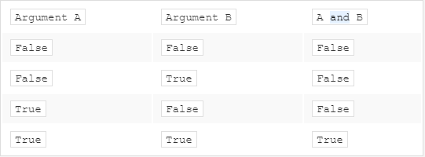
And Operator truth table
Notes:
and
One logical conjunction operator in Python is the word and. It's a binary operator with a priority that is lower than the one expressed by the comparison operators. It allows us to code complex conditions without the use of parentheses like this one:
counter > 0 and value == 100 The result provided by the and operator can be determined on the basis of the truth table.
If we consider the conjunction of A and B, the set of possible values of arguments and corresponding values of the conjunction looks as follows:

Slide 64
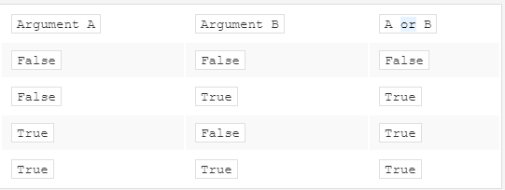
OR Operator truth table
Notes:
or
A disjunction operator is the word or. It's a binary operator with a lower priority than and (just like + compared to *). Its truth table is as follows:

Slide 65
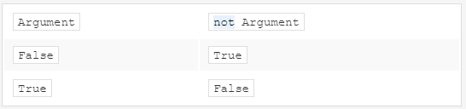
Not Operator truth table
Notes:
not
In addition, there's another operator that can be applied for constructing conditions. It's a unary operator performing a logical negation. Its operation is simple: it turns truth into falsehood and falsehood into truth.
This operator is written as the word not, and its priority is very high: the same as the unary + and -. Its truth table is simple:

Slide 66
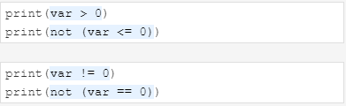


Logical expressions
Var = 1
Notes:
Logical expressions
Let's create a variable named var and assign 1 to it. The following conditions are pairwise equivalent:
First figure
You may be familiar with De Morgan's laws. They say that:
The negation of a conjunction is the disjunction of the negations.
The negation of a disjunction is the conjunction of the negations.
Let's write the same thing using Python:
Second Figure

Slide 67
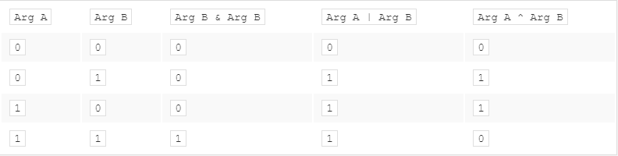
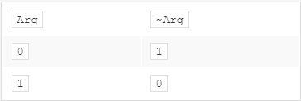
Bitwise operators
Notes:
Logical values vs. single bits
Logical operators take their arguments as a whole regardless of how many bits they contain. The operators are aware only of the value: zero (when all the bits are reset) means False; not zero (when at least one bit is set) means True.
The result of their operations is one of these values: False or True. This means that this snippet will assign the value True to the j variable if i is not zero; otherwise, it will be False.
Bitwise operators
However, there are four operators that allow you to manipulate single bits of data. They are called bitwise operators.
They cover all the operations we mentioned before in the logical context, and one additional operator. This is the xor (as in exclusive or) operator, and is denoted as ^ (caret).
Here are all of them:
& (ampersand) - bitwise conjunction;
| (bar) - bitwise disjunction;
~ (tilde) - bitwise negation;
^ (caret) - bitwise exclusive or (xor).

Slide 68
Bitwise operators
& requires exactly two 1s to provide 1 as the result;
| requires at least one 1 to provide 1 as the result;
^ requires exactly one 1 to provide 1 as the result.
the arguments of these operators must be integers
the logical operators do not penetrate into the bit level of its argument
Bitwise operators are stricter: they deal with every bit separately
Notes:
Let's make it easier:
& requires exactly two 1s to provide 1 as the result;
| requires at least one 1 to provide 1 as the result;
^ requires exactly one 1 to provide 1 as the result.
Let us add an important remark: the arguments of these operators must be integers; we must not use floats here.
The difference in the operation of the logical and bit operators is important: the logical operators do not penetrate into the bit level of its argument. They're only interested in the final integer value.
Bitwise operators are stricter: they deal with every bit separately. If we assume that the integer variable occupies 64 bits (which is common in modern computer systems), you can imagine the bitwise operation as a 64-fold evaluation of the logical operator for each pair of bits of the arguments. This analogy is obviously imperfect, as in the real world all these 64 operations are performed at the same time (simultaneously).

Slide 69


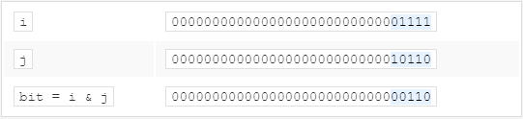
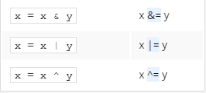
Logical values vs. Single bit operations: Logical operators vs.Bitwise operators
Notes:
Each of these two-argument operators can be used in abbreviated form. These are the examples of their equivalent notations:

Slide 70
How do we deal with single bits?
1. Check the state of your bit
2. Reset your bit
x & 1 = x
x & 0 = 0
Such a sequence of zeros and ones, whose task is to grab the value or to change the selected bits, is called a bit mask.
3. Set your bit
x | 1 = 1
x | 0 = x
4. Negate your bit
x ^ 1 = ~x
x ^ 0 = x
101011011
111111000
101011000
101011011
000000111
101011111
101011011
000000111
101011100
Notes:
1. Check the state of your bit - you want to find out the value of your bit; comparing the whole variable to zero will not do anything, because the remaining bits can have completely unpredictable values, but you can use the following conjunction property:
x & 1 = x x & 0 = 0
2. Reset your bit - you assign a zero to the bit while all the other bits must remain unchanged; let's use the same property of the conjunction as before, but let's use a slightly different mask - exactly as below: 3. Set your bit - you assign a 1 to your bit, while all the remaining bits must remain unchanged; use the following disjunction property:
x | 1 = 1 x | 0 = x
4. Negate your bit - you replace a 1 with a 0 and a 0 with a 1. You can use an interesting property of the xor operator:
x ^ 1 = ~x x ^ 0 = x

Slide 71

Binary left shift and binary right shift
12345 × 10 = 123450
multiplying by ten is in fact a shift of all the digits to the left and filling the resulting gap with zero
12340 ÷ 10 = 1234
Dividing by ten is nothing but shifting the digits to the right
The shift operators in Python are a pair of digraphs: << and >>
value << bits
value >> bits
Do not forget
Left << multiply by 2
Right >> divide by 2 //
Notes:
Python offers yet another operation relating to single bits: shifting. This is applied only to integer values, and you mustn't use floats as arguments for it.
You already apply this operation very often and quite unconsciously. How do you multiply any number by ten? Take a look:
12345 × 10 = 123450 As you can see, multiplying by ten is in fact a shift of all the digits to the left and filling the resulting gap with zero.
Division by ten? Take a look:
12340 ÷ 10 = 1234 Dividing by ten is nothing but shifting the digits to the right.
The same kind of operation is performed by the computer, but with one difference: as two is the base for binary numbers (not 10), shifting a value one bit to the left thus corresponds to multiplying it by two; respectively, shifting one bit to the right is like dividing by two (notice that the rightmost bit is lost).
The shift operators in Python are a pair of digraphs: << and >>, clearly suggesting in which direction the shift will act.
value << bits value >> bits The left argument of these operators is an integer value whose bits are shifted. The right argument determines the size of the shift.
It shows that this operation is certainly not commutative.
The priority of these operators is very high. You'll see them in the updated table of priorities, which we'll show you at the end of this section.
Take a look at the shifts in the editor window.
The final print() invocation produces the following output:
17 68 8 Note:
17 // 2 → 8 (shifting to the right by one bit is the same as integer division by two)
17 * 4 → 68 (shifting to the left by two bits is the same as integer multiplication by four)
var = 17
varRight = var >> 1
varLeft = var << 2
print(var, varLeft, varRight)

Slide 72
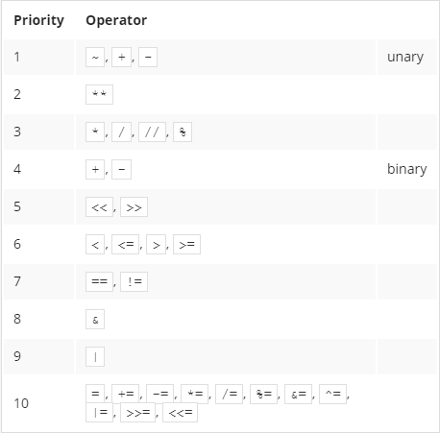
The updated priority table

Slide 73
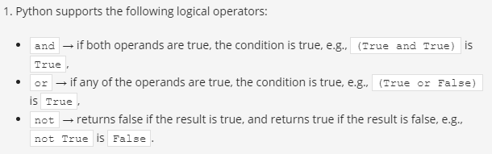
Key takeaway

Slide 74
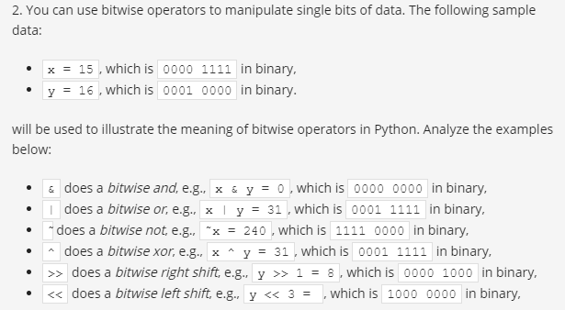

Slide 75
Exercise
Exercise 1
What is the output of the following snippet?
x = 1
y = 0
z = ((x == y) and (x == y)) or not(x == y)
print(not(z))
Exercise 2
What is the output of the following snippet?
x = 4
y = 1
a = x & y b = x | y c = ~x d = x ^ 5 e = x >> 2 f = x << 2
print(a, b, c, d, e, f)
Notes:
Exercise 1
What is the output of the following snippet?
x = 1 y = 0 z = ((x == y) and (x == y)) or not(x == y) print(not(z)) CheckFalse
Exercise 2
What is the output of the following snippet?
x = 4 y = 1 a = x & y b = x | y c = ~x d = x ^ 5 e = x >> 2 f = x << 2 print(a, b, c, d, e, f) Check0 5 -5 1 1 16

Slide 76
Lists - collections of data
List form
numbers = [10, 5, 7, 2, 1]
Indexing lists
numbers[0] = 111 => numbers= [111, 5, 7, 2, 1]
numbers[1] = numbers[4] => numbers= [111, 1, 7, 2, 1]
Notes:
How do you change the value of a chosen element in the list?
Let's assign a new value of 111 to the first element in the list. We do it this way:
numbers = [10, 5, 7, 2, 1] print("Original list content:", numbers) # printing original list content numbers[0] = 111 print("New list content: ", numbers) # current list content And now we want the value of the fifth element to be copied to the second element - can you guess how to do it?
numbers = [10, 5, 7, 2, 1] print("Original list content:", numbers) # printing original list content numbers[0] = 111 print("\nPrevious list content:", numbers) # printing previous list content numbers[1] = numbers[4] # copying value of the fifth element to the second print("New list content:", numbers) # printing current list content The value inside the brackets which selects one element of the list is called an index, while the operation of selecting an element from the list is known as indexing.
We're going to use the print() function to print the list content each time we make the changes. This will help us follow each step more carefully and see what's going on after a particular list modification.
Note: all the indices used so far are literals. Their values are fixed at runtime, but any expression can be the index, too. This opens up lots of possibilities.

Slide 77
Accessing list content
print(numbers) # printing the whole list
print(numbers[0]) # accessing the list's first element
The len() function
print("\nList length:", len(numbers)) # printing the list's length
Removing elements from a list
del numbers[1] # it's an instruction, not a function
print(len(numbers)) print(numbers)
You can't access an element which doesn't exist - Both of these instructions will cause runtime errors now:
print(numbers[4])
numbers[4] = 1
Notes:
Accessing list content
Each of the list's elements may be accessed separately. For example, it can be printed:
print(numbers[0]) # accessing the list's first element Assuming that all of the previous operations have been completed successfully, the snippet will send 111 to the console.
As you can see in the editor, the list may also be printed as a whole - just like here:
print(numbers) # printing the whole list As you've probably noticed before, Python decorates the output in a way that suggests that all the presented values form a list. The output from the example snippet above looks like this:
[111, 1, 7, 2, 1] The len() function
The length of a list may vary during execution. New elements may be added to the list, while others may be removed from it. This means that the list is a very dynamic entity.
If you want to check the list's current length, you can use a function named len() (its name comes from length).
The function takes the list's name as an argument, and returns the number of elements currently stored inside the list (in other words - the list's length).
Look at the last line of code in the editor, run the program and check what value it will print to the console. Can you guess?
Removing elements from a list
Any of the list's elements may be removed at any time - this is done with an instruction named del (delete). Note: it's an instruction, not a function.
You have to point to the element to be removed - it'll vanish from the list, and the list's length will be reduced by one.
Look at the snippet below. Can you guess what output it will produce? Run the program in the editor and check.
del numbers[1] print(len(numbers)) print(numbers) You can't access an element which doesn't exist - you can neither get its value nor assign it a value. Both of these instructions will cause runtime errors now:
print(numbers[4]) numbers[4] = 1 Add the snippet above after the last line of code in the editor, run the program and check what happens.
Note: we've removed one of the list's elements - there are only four elements in the list now. This means that element number four doesn't exist.

Slide 78
Negative indices are legal
An element with an index equal to -1 is the last one in the list.
print(numbers[-1])
Similarly, the element with an index equal to -2 is the one before last in the list.
print(numbers[-2])
The last accessible element in our list is numbers[-4] (the first one)
0 1 2 3 4
[10, 5, 7, 2, 1]
-5 -4 -3 -2 -1
Notes:
Negative indices are legal
It may look strange, but negative indices are legal, and can be very useful.
An element with an index equal to -1 is the last one in the list.
print(numbers[-1]) The example snippet will output 1. Run the program and check.
Similarly, the element with an index equal to -2 is the one before last in the list.
print(numbers[-2]) The example snippet will output 2.
The last accessible element in our list is numbers[-4] (the first one) - don't try to go any further!

Slide 79
LAB Estimated time
5 minutes
Level of difficulty
Very easy
Scenario
There once was a hat. The hat contained no rabbit, but a list of five numbers: 1, 2, 3, 4, and 5.
Your task is to:
write a line of code that prompts the user to replace the middle number in the list with an integer number entered by the user (step 1)
write a line of code that removes the last element from the list (step 2)
write a line of code that prints the length of the existing list (step 3.)
Ready for this challenge?
Notes:
LAB Estimated time
5 minutes
Level of difficulty
Very easy
Objectives
Familiarize the student with:
using basic instructions related to lists;
creating and modifying lists.
Scenario
There once was a hat. The hat contained no rabbit, but a list of five numbers: 1, 2, 3, 4, and 5.
Your task is to:
write a line of code that prompts the user to replace the middle number in the list with an integer number entered by the user (step 1)
write a line of code that removes the last element from the list (step 2)
write a line of code that prints the length of the existing list (step 3.)
Ready for this challenge?

Slide 80
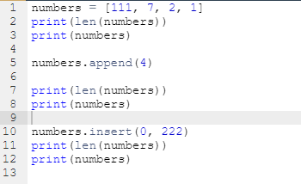
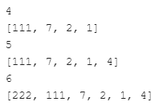
Adding elements to a list: append() and insert()
A new element may be glued to the end of the existing list:
list.append(value)
The insert() method is a bit smarter - it can add a new element at any place in the list, not only at the end.
list.insert(location, value)
Notes:
Adding elements to a list: append() and insert()
A new element may be glued to the end of the existing list:
list.append(value) Such an operation is performed by a method named append(). It takes its argument's value and puts it at the end of the list which owns the method.
The list's length then increases by one.
The insert() method is a bit smarter - it can add a new element at any place in the list, not only at the end.
list.insert(location, value) It takes two arguments:
the first shows the required location of the element to be inserted; note: all the existing elements that occupy locations to the right of the new element (including the one at the indicated position) are shifted to the right, in order to make space for the new element;
the second is the element to be inserted.
Look at the code in the editor. See how we use the append() and insert() methods. Pay attention to what happens after using insert(): the former first element is now the second, the second the third, and so on.
Add the following snippet after the last line of code in the editor:
numbers.insert(1, 333) Print the final list content to the screen and see what happens. The snippet above snippet inserts 333 into the list, making it the second element. The former second element becomes the third, the third the fourth, and so on.
numbers = [111, 7, 2, 1]
print(len(numbers))
print(numbers)
###
numbers.append(4)
print(len(numbers))
print(numbers)
###
numbers.insert(0, 222)
print(len(numbers))
print(numbers)

Slide 81
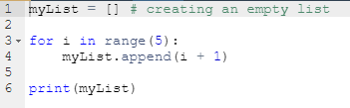
Adding elements to a list: continued
[1, 2, 3, 4, 5]
Notes:
You can start a list's life by making it empty (this is done with an empty pair of square brackets) and then adding new elements to it as needed.
Take a look at the snippet in the editor. Try to guess its output after the for loop execution. Run the program to check if you were right.
It'll be a sequence of consecutive integer numbers from 1 (you then add one to all the appended values) to 5.
We've modified the snippet a bit:
myList = [] # creating an empty list for i in range(5): myList.insert(0, i + 1) print(myList) what will happen now? Run the program and check if this time you were right, too.
You should get the same sequence, but in reverse order (this is the merit of using the insert() method).
myList = [] # creating an empty list
for i in range(5):
myList.append(i + 1)
print(myList)

Slide 82


Summation of List
Notes:
The second face of the for loop
But the for loop can do much more. It can hide all the actions connected to the list's indexing, and deliver all the list's elements in a handy way.
This modified snippet shows how it works:
myList = [10, 1, 8, 3, 5] total = 0 for i in myList: total += i print(total) What happens here?
the for instruction specifies the variable used to browse the list (i here) followed by the in keyword and the name of the list being processed (myList here)
the i variable is assigned the values of all the subsequent list's elements, and the process occurs as many times as there are elements in the list;
this means that you use the i variable as a copy of the elements' values, and you don't need to use indices;
the len() function is not needed here, either.
myList = [10, 1, 8, 3, 5]
total = 0
for i in range(len(myList)):
total += myList[i]
print(total)
myList = [10, 1, 8, 3, 5]
total = 0
for i in myList:
total += i
print(total)

Slide 83

Swapping list elements
Notes:
Lists in action
Let's leave lists aside for a short moment and look at one intriguing issue.
Imagine that you need to rearrange the elements of a list, i.e., reverse the order of the elements: the first and the fifth as well as the second and fourth elements will be swapped. The third one will remain untouched.
Question: how can you swap the values of two variables?
Take a look at the snippet:
variable1 = 1 variable2 = 2 variable2 = variable1 variable1 = variable2 If you do something like this, you would lose the value previously stored in variable2. Changing the order of the assignments will not help. You need a third variable that serves as an auxiliary storage.
This is how you can do it:
variable1 = 1 variable2 = 2 auxiliary = variable1 variable1 = variable2 variable2 = auxiliary Python offers a more convenient way of doing the swap - take a look:
variable1 = 1 variable2 = 2 variable1, variable2 = variable2, variable1 Clear, effective and elegant - isn't it?
variable1 = 1
variable2 = 2
variable1, variable2 = variable2, variable1
myList = [10, 1, 8, 3, 5]
myList[0], myList[4] = myList[4], myList[0]
myList[1], myList[3] = myList[3], myList[1]
print(myList)

Slide 84
LAB Estimated time
10-15 minutes
Level of difficulty
Easy
Scenario
The Beatles were one of the most popular music group of the 1960s, and the best-selling band in history. Some people consider them to be the most influential act of the rock era. Indeed, they were included in Time magazine's compilation of the 20th Century's 100 most influential people.
The band underwent many line-up changes, culminating in 1962 with the line-up of John Lennon, Paul McCartney, George Harrison, and Richard Starkey (better known as Ringo Starr).
Write a program that reflects these changes and lets you practice with the concept of lists. Your task is to:
step 1: create an empty list named beatles;
step 2: use the append() method to add the following members of the band to the list: John Lennon, Paul McCartney, and George Harrison;
step 3: use the for loop and the append() method to prompt the user to add the following members of the band to the list: Stu Sutcliffe, and Pete Best;
step 4: use the del instruction to remove Stu Sutcliffe and Pete Best from the list;
step 5: use the insert() method to add Ringo Starr to the beginning of the list.
By the way, are you a Beatles fan?

Slide 85

Key Takeaway

Slide 86

Key Takeaway

Slide 87

Key Takeaway

Slide 88
Exercise 1
What is the output of the following snippet?
lst = [1, 2, 3, 4, 5]
lst.insert(1, 6)
del lst[0]
lst.append(1) print(lst)
Exercise 2
What is the output of the following snippet?
lst = [1, 2, 3, 4, 5]
lst2 = []
add = 0
for number in lst:
add += number lst2.append(add)
print(lst2)
Notes:
Exercise 1
What is the output of the following snippet?
lst = [1, 2, 3, 4, 5] lst.insert(1, 6) del lst[0] lst.append(1) print(lst) Check
[6, 2, 3, 4, 5, 1]
Exercise 2
What is the output of the following snippet?
lst = [1, 2, 3, 4, 5] lst2 = [] add = 0 for number in lst: add += number lst2.append(add) print(lst2) Check
[1, 3, 6, 10, 15]
Exercise 3
What happens when you run the following snippet?
lst = [] del lst print(lst) Check
NameError: name 'lst' is not defined
Exercise 4
What is the output of the following snippet?
lst = [1, [2, 3], 4] print(lst[1]) print(len(lst)) Check
[2, 3] 3

Slide 89
Exercise 3
What happens when you run the following snippet?
lst = []
del lst
print(lst)
Exercise 4
What is the output of the following snippet?
lst = [1, [2, 3], 4]
print(lst[1])
print(len(lst))

Slide 90


Sorting a list
Notes:
Sorting a list
How many passes do we need to sort the entire list?
We solve this issue in the following way: we introduce another variable; its task is to observe if any swap has been done during the pass or not; if there is no swap, then the list is already sorted, and nothing more has to be done. We create a variable named swapped, and we assign a value of False to it, to indicate that there are no swaps. Otherwise, it will be assigned True.
for i in range(len(myList) - 1): # we need (5 - 1) comparisons
if myList[i] > myList[i + 1]: # compare adjacent elements
myList[i], myList[i + 1] = myList[i + 1], myList[i] # if we end up here it means that we have to swap the elements
print(myList)
myList = [8, 10, 6, 2, 4] # list to sort
swapped = True # it's a little fake - we need it to enter the while loop
while swapped:
swapped = False # no swaps so far
for i in range(len(myList) - 1):
if myList[i] > myList[i + 1]:
swapped = True # swap occured!
myList[i], myList[i + 1] = myList[i + 1], myList[i]
print(myList)

Slide 91

The bubble sort - interactive version
Notes:
In the editor you can see a complete program, enriched by a conversation with the user, and allowing the user to enter and to print elements from the list: The bubble sort - final interactive version.
Python, however, has its own sorting mechanisms. No one needs to write their own sorts, as there is a sufficient number of ready-to-use tools.
We explained this sorting system to you because it's important to learn how to process a list's contents, and to show you how real sorting may work.
If you want Python to sort your list, you can do it like this:
myList = [8, 10, 6, 2, 4] myList.sort() print(myList) It is as simple as that.
The snippet's output is as follows:
[2, 4, 6, 8, 10] As you can see, all the lists have a method named sort(), which sorts them as fast as possible. You've already learned about some of the list methods before, and you're going to learn more about others very soon.
myList = [8, 10, 6, 2, 4] # list to sort
myList = []
swapped = True
num = int(input("How many elements do you want to sort: "))
for i in range(num):
val = float(input("Enter a list element: "))
myList.append(val)
while swapped:
swapped = False
for i in range(len(myList) - 1):
if myList[i] > myList[i + 1]:
swapped = True
myList[i], myList[i + 1] = myList[i + 1], myList[i]
print("\nSorted:")
print(myList)

Slide 92

Key take away

Slide 93
Exercise 1
What is the output of the following snippet?
lst = ["D", "F", "A", "Z"]
lst.sort()
print(lst)
Exercise 2
What is the output of the following snippet?
a = 3
b = 1
c = 2
lst = [a, c, b]
lst.sort()
print(lst)
Notes:
Exercise 1
What is the output of the following snippet?
lst = ["D", "F", "A", "Z"] lst.sort() print(lst) Check['A', 'D', 'F', 'Z']
Exercise 2
What is the output of the following snippet?
a = 3 b = 1 c = 2 lst = [a, c, b] lst.sort() print(lst) Check[1, 2, 3]
Exercise 3
What is the output of the following snippet?
a = "A" b = "B" c = "C" d = " " lst = [a, b, c, d] lst.reverse() print(lst) Check[' ', 'C', 'B', 'A']

Slide 94
Exercises
Exercise 3
What is the output of the following snippet?
a = "A"
b = "B"
c = "C"
d = " "
lst = [a, b, c, d]
lst.reverse()
print(lst)

Slide 95

The inner life of lists
The name of an ordinary variable is the name of its content;
The name of a list is the name of a memory location where the list is stored.
The assignment: list2 = list1 copies the name of the array, not its contents.
In effect, the two names (list1 and list2) identify the same location in the computer memory.
Modifying one of them affects the other, and vice versa.
Notes:
Now we want to show you one important, and very surprising, feature of lists, which strongly distinguishes them from ordinary variables.
We want you to memorize it - it may affect your future programs, and cause severe problems if forgotten or overlooked.
Take a look at the snippet in the editor.
The program:
creates a one-element list named list1;
assigns it to a new list named list2;
changes the only element of list1;
prints out list2.
The surprising part is the fact that the program will output: [2], not [1], which seems to be the obvious solution.
Lists (and many other complex Python entities) are stored in different ways than ordinary (scalar) variables.
You could say that:
the name of an ordinary variable is the name of its content;
the name of a list is the name of a memory location where the list is stored.
Read these two lines once more - the difference is essential for understanding what we are going to talk about next.
The assignment: list2 = list1 copies the name of the array, not its contents. In effect, the two names (list1 and list2) identify the same location in the computer memory. Modifying one of them affects the other, and vice versa.
How do you cope with that?

Slide 96

Powerful slices
A slice is an element of Python syntax that allows you to make a brand new copy of a list, or parts of a list.
It actually copies the list's contents, not the list's name.
myList[start:end]
start is the index of the first element included in the slice;
end is the index of the first element not included in the slice
Notes:
Fortunately, the solution is at your fingertips - its name is the slice.
A slice is an element of Python syntax that allows you to make a brand new copy of a list, or parts of a list.
It actually copies the list's contents, not the list's name.
This is exactly what you need. Take a look at the snippet below:
list1 = [1]
list2 = list1[:]
list1[0] = 2
print(list2) Its output is [1].
This inconspicuous part of the code described as [:] is able to produce a brand new list.
One of the most general forms of the slice looks as follows:
myList[start:end] As you can see, it resembles indexing, but the colon inside makes a big difference.
A slice of this form makes a new (target) list, taking elements from the source list - the elements of the indices from start to end - 1.
Note: not to end but to end - 1. An element with an index equal to end is the first element which does not take part in the slicing.
Using negative values for both start and end is possible (just like in indexing).
Take a look at the snippet:
myList = [10, 8, 6, 4, 2] newList = myList[1:3] print(newList) The newList list will have end - start (3 - 1 = 2) elements - the ones with indices equal to 1 and 2 (but not 3).
The snippet's output is: [8, 6]

Slide 97

Slices - negative indices
If the start specifies an element lying further than the one described by the end (from the list's beginning point of view), the slice will be empty
Notes:
Slices - negative indices
Look at the snippet below:
myList[start:end] To repeat:
start is the index of the first element included in the slice;
end is the index of the first element not included in the slice.
This is how negative indices work with the slice:
myList = [10, 8, 6, 4, 2] newList = myList[1:-1] print(newList) The snippet's output is: [8, 6, 4].
If the start specifies an element lying further than the one described by the end (from the list's beginning point of view), the slice will be empty:
myList = [10, 8, 6, 4, 2] newList = myList[-1:1] print(newList) The snippet's output is: [].

Slide 98



Slices: continued
the slice of this form:
myList[:end] is a more compact equivalent of: myList[0:end]
the slice of this form:
myList[start:] is a more compact equivalent of: myList[start:len(myList)]
omitting both start and end makes a copy of the whole list:
Notes:
Slices: continued
If you omit the start in your slice, it is assumed that you want to get a slice beginning at the element with index 0.
In other words, the slice of this form:
myList[:end] is a more compact equivalent of:
myList[0:end] Look at the snippet below:
myList = [10, 8, 6, 4, 2] newList = myList[:3] print(newList) This is why its output is: [10, 8, 6].
Similarly, if you omit the end in your slice, it is assumed that you want the slice to end at the element with the index len(myList).
In other words, the slice of this form:
myList[start:] is a more compact equivalent of:
myList[start:len(myList)] Look at the following snippet:
myList = [10, 8, 6, 4, 2] newList = myList[3:] print(newList) Its output is therefore: [4, 2].

Slide 99



del instruction
del instruction is able to delete slices
Deleting all the elements at once is possible too
The del instruction will delete the list itself, not its content
Notes:
The previously described del instruction is able to delete more than just a list's element at once - it can delete slices too:
myList = [10, 8, 6, 4, 2] del myList[1:3] print(myList) Note: in this case, the slice doesn't produce any new list!
The snippet's output is: [10, 4, 2].
Deleting all the elements at once is possible too:
myList = [10, 8, 6, 4, 2] del myList[:] print(myList) The list becomes empty, and the output is: [].
Removing the slice from the code changes its meaning dramatically.
Take a look:
myList = [10, 8, 6, 4, 2] del myList print(myList) The del instruction will delete the list itself, not its content.
The print() function invocation from the last line of the code will then cause a runtime error.

Slide 100


The in and not in operators
The first of them (in) checks if a given element is currently stored somewhere inside the list - the operator returns True in this case.
The second (not in) checks if a given element is absent in a list - the operator returns True in this case.
Notes:
Python offers two very powerful operators, able to look through the list in order to check whether a specific value is stored inside the list or not.
These operators are:
elem in myList elem not in myList The first of them (in) checks if a given element (its left argument) is currently stored somewhere inside the list (the right argument) - the operator returns True in this case.
The second (not in) checks if a given element (its left argument) is absent in a list - the operator returns True in this case.
Look at the code in the editor. The snippet shows both operators in action. Can you guess its output? Run the program to check if you were right.

Slide 101


Lists - some simple programs
The first of them tries to find the greater value in the list
If you need to save computer power, you can use a slice:
Notes:
Lists - some simple programs
Now we want to show you some simple programs utilizing lists.
The first of them tries to find the greater value in the list. Look at the code in the editor.
The concept is rather simple - we temporarily assume that the first element is the largest one, and check the hypothesis against all the remaining elements in the list.
The code outputs 17 (as expected).
The code may be rewritten to make use of the newly introduced form of the for loop:
myList = [17, 3, 11, 5, 1, 9, 7, 15, 13] largest = myList[0] for i in myList: if i > largest: largest = i print(largest) The program above performs one unnecessary comparison, when the first element is compared with itself, but this isn't a problem at all.
The code outputs 17, too (nothing unusual).
If you need to save computer power, you can use a slice:
myList = [17, 3, 11, 5, 1, 9, 7, 15, 13] largest = myList[0] for i in myList[1:]: if i > largest: largest = i print(largest) The question is: which of these two actions consumes more computer resources - just one comparison, or slicing almost all of a list's elements?

Slide 102


Lists - some simple programs
let's find the location of a given element inside a list:
how many numbers have you hit?
Notes:
Now let's find the location of a given element inside a list:
myList = [1, 2, 3, 4, 5, 6, 7, 8, 9, 10] toFind = 5 found = False for i in range(len(myList)): found = myList[i] == toFind if found: break if found: print("Element found at index", i) else: print("absent") Note:
the target value is stored in the toFind variable;
the current status of the search is stored in the found variable (True/False)
when found becomes True, the for loop is exited.
Let's assume that you've chosen the following numbers in the lottery: 3, 7, 11, 42, 34, 49.
The numbers that have been drawn are: 5, 11, 9, 42, 3, 49.
The question is: how many numbers have you hit?
The program will give you the answer:
drawn = [5, 11, 9, 42, 3, 49] bets = [3, 7, 11, 42, 34, 49] hits = 0 for number in bets: if number in drawn: hits += 1 print(hits) Note:
the drawn list stores all the drawn numbers;
the bets list stores your bets;
the hits variable counts your hits.
The program output is: 4.

Slide 103
LAB Estimated time
10-15 minutes
Level of difficulty
Easy
Scenario
Imagine a list - not very long, not very complicated, just a simple list containing some integer numbers. Some of these numbers may be repeated, and this is the clue. We don't want any repetitions. We want them to be removed.
Your task is to write a program which removes all the number repetitions from the list. The goal is to have a list in which all the numbers appear not more than once.
Note: assume that the source list is hard-coded inside the code - you don't have to enter it from the keyboard. Of course, you can improve the code and add a part that can carry out a conversation with the user and obtain all the data from her/him.
Hint: we encourage you to create a new list as a temporary work area - you don't need to update the list in situ.
We've provided no test data, as that would be too easy. You can use our skeleton instead.
Notes:
LAB Estimated time
10-15 minutes
Level of difficulty
Easy
Scenario
Imagine a list - not very long, not very complicated, just a simple list containing some integer numbers. Some of these numbers may be repeated, and this is the clue. We don't want any repetitions. We want them to be removed.
Your task is to write a program which removes all the number repetitions from the list. The goal is to have a list in which all the numbers appear not more than once.
Note: assume that the source list is hard-coded inside the code - you don't have to enter it from the keyboard. Of course, you can improve the code and add a part that can carry out a conversation with the user and obtain all the data from her/him.
Hint: we encourage you to create a new list as a temporary work area - you don't need to update the list in situ.
We've provided no test data, as that would be too easy. You can use our skeleton instead.

Slide 104

Key takeaway

Slide 105

Key takeaway

Slide 106

Key takeaway

Slide 107

Exercise
Notes:
['C']

Slide 108

Exercise
Notes:
['B', 'C']

Slide 109

Exercise
Notes:
[]

Slide 110

Exercise
Notes:
['A', 'B', 'C']

Slide 111

Exercise
Notes:
myList = [1, 2, "in", True, "ABC"] print(1 in myList) # outputs True print("A" not in myList) # outputs True print(3 not in myList) # outputs True print(False in myList) # outputs False

Slide 112
Lists in lists
list comprehension: is aspecial syntax used by Python in order to fill massive lists.
A list comprehension is actually a list, but created on-the-fly during program execution, and is not described statically.
list comprehension examples
Example #1:
squares = [x ** 2 for x in range(10)]
squares = [0, 1, 4, 9, 16, 25, 36, 49, 64, 81]
Example #2:
twos = [2 ** i for i in range(8)]
twos = 1, 2, 4, 8, 16, 32, 64, 128]
Example #3:
odds = [x for x in squares if x % 2 != 0 ]
Notes:
Lists in lists
Lists can consist of scalars (namely numbers) and elements of a much more complex structure (you've already seen such examples as strings, booleans, or even other lists in the previous Section Summary lessons). Let's have a closer look at the case where a list's elements are just lists.
We often find such arrays in our lives. Probably the best example of this is a chessboard.
A chessboard is composed of rows and columns. There are eight rows and eight columns. Each column is marked with the letters A through H. Each line is marked with a number from one to eight.
The location of each field is identified by letter-digit pairs. Thus, we know that the bottom right corner of the board (the one with the white rook) is A1, while the opposite corner is H8.
Let's assume that we're able to use the selected numbers to represent any chess piece. We can also assume that every row on the chessboard is a list.
Look at the code below:
row = [] for i in range(8): row.append(WHITE_PAWN) It builds a list containing eight elements representing the second row of the chessboard - the one filled with pawns (assume that WHITE_PAWN is a predefined symbol representing a white pawn).
The same effect may be achieved by means of a list comprehension, the special syntax used by Python in order to fill massive lists.
A list comprehension is actually a list, but created on-the-fly during program execution, and is not described statically.
Take a look at the snippet:
row = [WHITE_PAWN for i in range(8)] The part of the code placed inside the brackets specifies:
the data to be used to fill the list (WHITE_PAWN)
the clause specifying how many times the data occurs inside the list (for i in range(8))
Let us show you some other list comprehension examples:
Example #1:
squares = [x ** 2 for x in range(10)] The snippet produces a ten-element list filled with squares of ten integer numbers starting from zero (0, 1, 4, 9, 16, 25, 36, 49, 64, 81)
Example #2:
twos = [2 ** i for i in range(8)] The snippet creates an eight-element array containing the first eight powers of two (1, 2, 4, 8, 16, 32, 64, 128)
Example #3:
odds = [x for x in squares if x % 2 != 0 ] The snippet makes a list with only the odd elements of the squares list.

Slide 113
Lists in lists: two-dimensional arrays
board = []
for i in range(8):
row = [x for i in range(8)]
board.append(row)
board = [[x for i in range(8)] for j in range(8)]
Notes:
Lists in lists: two-dimensional arrays
Let's also assume that a predefined symbol named EMPTY designates an empty field on the chessboard.
So, if we want to create a list of lists representing the whole chessboard, it may be done in the following way:
board = [] for i in range(8): row = [EMPTY for i in range(8)] board.append(row) Note:
the inner part of the loop creates a row consisting of eight elements (each of them equal to EMPTY) and appends it to the board list;
the outer part repeats it eight times;
in total, the board list consists of 64 elements (all equal to EMPTY)
This model perfectly mimics the real chessboard, which is in fact an eight-element list of elements, all being single rows. Let's summarize our observations:
the elements of the rows are fields, eight of them per row;
the elements of the chessboard are rows, eight of them per chessboard.
The board variable is now a two-dimensional array. It's also called, by analogy to algebraic terms, a matrix.
As list comprehensions can be nested, we can shorten the board creation in the following way:
board = [[EMPTY for i in range(8)] for j in range(8)] The inner part creates a row, and the outer part builds a list of rows.

Slide 114


Lists in lists: two-dimensional arrays - continued
Notes:
Lists in lists: two-dimensional arrays - continued
Access to the selected field of the board requires two indices - the first selects the row; the second - the field number inside the row, which is de facto a column number.
Take a look at the chessboard. Every field contains a pair of indices which should be given to access the field's content:
Glancing at the figure shown above, let's set some chess pieces on the board. First, let's add all the rooks:
board[0][0] = ROOK board[0][7] = ROOK board[7][0] = ROOK board[7][7] = ROOK If you want to add a knight to C4, you do it as follows:
board[4][2] = KNIGHT And now a pawn to E5:
board[3][4] = PAWN And now - experiment with the code in the editor.

Slide 115



Multidimensional nature of lists: advanced applications
Imagine that you develop a piece of software for an automatic weather station. The device records the air temperature on an hourly basis and does it throughout the month.
Now it's time to determine the monthly average noon temperature
Now find the highest temperature during the whole month
Now count the days when the temperature at noon was at least 20 ℃
Notes:
Multidimensional nature of lists: advanced applications
Let's go deeper into the multidimensional nature of lists. To find any element of a two-dimensional list, you have to use two coordinates:
a vertical one (row number)
and a horizontal one (column number).
Imagine that you develop a piece of software for an automatic weather station. The device records the air temperature on an hourly basis and does it throughout the month. This gives you a total of 24 × 31 = 744 values. Let's try to design a list capable of storing all these results.
First, you have to decide which data type would be adequate for this application. In this case, a float would be best, since this thermometer is able to measure the temperature with an accuracy of 0.1 ℃.
Then you take an arbitrary decision that the rows will record the readings every hour on the hour (so the row will have 24 elements) and each of the rows will be assigned to one day of the month (let's assume that each month has 31 days, so you need 31 rows). Here's the appropriate pair of comprehensions (h is for hour, d for day):
temps = [[0.0 for h in range(24)] for d in range(31)] The whole matrix is filled with zeros now. You can assume that it's updated automatically using special hardware agents. The thing you have to do is to wait for the matrix to be filled with measurements.
Now it's time to determine the monthly average noon temperature. Add up all 31 readings recorded at noon and divide the sum by 31. You can assume that the midnight temperature is stored first. Here's the relevant code:
temps = [[0.0 for h in range(24)] for d in range(31)] # # the matrix is magically updated here # total = 0.0 for day in temps: total += day[11] average = total / 31 print("Average temperature at noon:", average) Note: the day variable used by the for loop is not a scalar - each pass through the temps matrix assigns it with the subsequent rows of the matrix; hence, it's a list. It has to be indexed with 11 to access the temperature value measured at noon.
Now find the highest temperature during the whole month - see the code:
temps = [[0.0 for h in range(24)] for d in range(31)] # # the matrix is magically updated here # highest = -100.0 for day in temps: for temp in day: if temp > highest: highest = temp print("The highest temperature was:", highest) Note:
the day variable iterates through all the rows in the temps matrix;
the temp variable iterates through all the measurements taken in one day.
Now count the days when the temperature at noon was at least 20 ℃:
temps = [[0.0 for h in range(24)] for d in range(31)] # # the matrix is magically updated here # hotDays = 0 for day in temps: if day[11] > 20.0: hotDays += 1 print(hotDays, "days were hot.")

Slide 116
Three-dimensional arrays
Imagine a hotel. It's a huge hotel consisting of
three buildings,
15 floors each.
There are 20 rooms on each floor.
For this, you need an array which can collect and process information on the occupied/free rooms.
First step - the type of the array's elements. In this case, a Boolean value (True/False) would fit.
Step two - calm analysis of the situation. Summarize the available information: three buildings, 15 floors, 20 rooms.
Now you can create the array:
rooms = [[[False for r in range(20)] for f in range(15)] for t in range(3)] The first index (0 through 2) selects one of the buildings; the second (0 through 14) selects the floor, the third (0 through 19) selects the room number. All rooms are initially free.
Notes:
Three-dimensional arrays
Python does not limit the depth of list-in-list inclusion. Here you can see an example of a three-dimensional array:
Imagine a hotel. It's a huge hotel consisting of three buildings, 15 floors each. There are 20 rooms on each floor. For this, you need an array which can collect and process information on the occupied/free rooms.
First step - the type of the array's elements. In this case, a Boolean value (True/False) would fit.
Step two - calm analysis of the situation. Summarize the available information: three buildings, 15 floors, 20 rooms.
Now you can create the array:
rooms = [[[False for r in range(20)] for f in range(15)] for t in range(3)] The first index (0 through 2) selects one of the buildings; the second (0 through 14) selects the floor, the third (0 through 19) selects the room number. All rooms are initially free.
Congratulations! You've made it to the end of the module. Keep up the good work!

Slide 117
Now you can book a room for two newlyweds: in the second building, on the tenth floor, room 14:
rooms[1][9][13] = True
and release the second room on the fifth floor located in the first building:
rooms[0][4][1] = False
Check if there are any vacancies on the 15th floor of the third building:
vacancy = 0
for roomNumber in range(20):
if not rooms[2][14][roomNumber]:
vacancy += 1
Notes:
Now you can book a room for two newlyweds: in the second building, on the tenth floor, room 14:
rooms[1][9][13] = True and release the second room on the fifth floor located in the first building:
rooms[0][4][1] = False Check if there are any vacancies on the 15th floor of the third building:
vacancy = 0 for roomNumber in range(20): if not rooms[2][14][roomNumber]: vacancy += 1 The vacancy variable contains 0 if all the rooms are occupied, or the number of available rooms otherwise.

Slide 118

Key takeaway

Slide 119


Key takeaway

Slide 120


Key takeaway

Slide 121


Slide 122


